Slide 1
Perceptual Computing SDK Q2, 2013 Update
Building Momentum with the SDK
Barry Solomon, Senior Product Manager, Intel
Xintian Wu, Architect, Intel

Slide 2
Legal Disclaimer & Optimization Notice
INFORMATION IN THIS DOCUMENT IS PROVIDED “AS IS”. NO LICENSE, EXPRESS OR IMPLIED, BY ESTOPPEL OR OTHERWISE, TO ANY INTELLECTUAL PROPERTY RIGHTS IS GRANTED BY THIS DOCUMENT. INTEL ASSUMES NO LIABILITY WHATSOEVER AND INTEL DISCLAIMS ANY EXPRESS OR IMPLIED WARRANTY, RELATING TO THIS INFORMATION INCLUDING LIABILITY OR WARRANTIES RELATING TO FITNESS FOR A PARTICULAR PURPOSE, MERCHANTABILITY, OR INFRINGEMENT OF ANY PATENT, COPYRIGHT OR OTHER INTELLECTUAL PROPERTY RIGHT.
Software and workloads used in performance tests may have been optimized for performance only on Intel microprocessors. Performance tests, such as SYSmark and MobileMark, are measured using specific computer systems, components, software, operations and functions. Any change to any of those factors may cause the results to vary. You should consult other information and performance tests to assist you in fully evaluating your contemplated purchases, including the performance of that product when combined with other products.
Copyright © 2013 , Intel Corporation. All rights reserved. Intel, the Intel logo, Xeon, Core, VTune, and Cilk are trademarks of Intel Corporation in the U.S. and other countries.
Optimization Notice
Intel’s compilers may or may not optimize to the same degree for non-Intel microprocessors for optimizations that are not unique to Intel microprocessors. These optimizations include SSE2, SSE3, and SSSE3 instruction sets and other optimizations. Intel does not guarantee the availability, functionality, or effectiveness of any optimization on microprocessors not manufactured by Intel. Microprocessor-dependent optimizations in this product are intended for use with Intel microprocessors. Certain optimizations not specific to Intel microarchitecture are reserved for Intel microprocessors. Please refer to the applicable product User and Reference Guides for more information regarding the specific instruction sets covered by this notice. Notice revision #20110804
Copyright© 2013, Intel Corporation. All rights reserved. *Other brands and names are the property of their respective owners.

Slide 3
Legal Disclaimer
Software Source Code Disclaimer
Any software source code reprinted in this document is furnished under a software license (see http://software.intel.com/sites/products/vcsource/files/Intel_PCSDK_EULA.rtf ) and may only be used or copied in accordance with the terms of that license.
Roadmap Notice
All products, computer systems, dates and figures specified are preliminary based on current expectations, and are subject to change without notice.
Windows is a registered trademark of Microsoft Corporation in the United States and other countries.
Copyright© 2013, Intel Corporation. All rights reserved. *Other brands and names are the property of their respective owners.

Slide 4
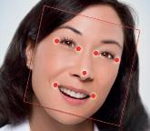
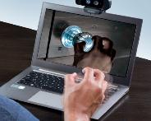
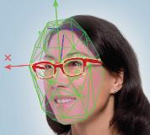
What is Perceptual Computing? Interactivity Beyond Touch, Mouse and Keyboard …
Facial Tracking
Close-range Gesture Tracking
Speech Recognition
Close-range Finger Tracking
Augmented Reality
Facilitates Application Developers Implementation of:
Games
Entertainment
Productivity
Accessibility
Immersive Teleconferencing
Education
Medical / Health
Enterprises
Retail
Industrial
Adding Senses to the Brain of the PC

Slide 5
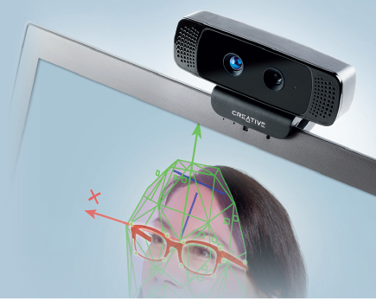
Creative* Interactive Gesture Camera
For Use with the Intel® Perceptual Computing SDK
Small, light-weight, low-power
Tuned for close-range interactivity.
Designed with ease of setup and portability
Includes:
HD web camera
Depth sensor
Dual-array microphones
Key Specs
RGB resolution: 720p
IR Depth resolution: QVGA (320x240)
Frame Rate: 30fps
Size: 4.27in x 2.03in x 2.11 in
Weight: 9.56 oz
Power: single USB2.0
Order at intel.com/software/perceptual
*Other brands and trademarks may be claimed as the property of their respective owners

Slide 6
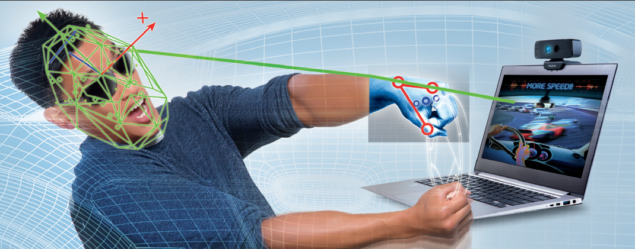
Perceptual Computing Interactivity for Intel® Core™ Processor-based Applications¹
Intel® Perceptual Computing SDK 2013
Create a New World of Interactivity
Download Available for Free at intel.com/software/perceptual
¹Intel Perceptual Computing is supported on 2nd, 3rd and 4th generation Intel Core Processors

Slide 7
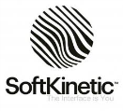
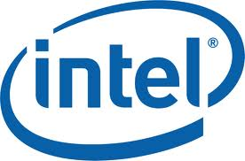
SDK Usage Modes Today¹
Close-range Depth Tracking (6 in. to 3 ft.):
Recognize the positions of each of the user’s hands, fingers, static hand poses and moving hand gestures.
Facial Analysis:
Face detection and recognition (six and seven point landmark and attribution detection, including smiles, blinks, and age groups)
Augmented Reality:
Combine real-time images from the camera and close-range tracking from the depth sensor with 2D or 3D graphical images.
Speech Recognition:
Voice command and control, short sentence dictation, and text to speech synthesis
¹ New usage modes may be added in the future

Slide 8
Your SDK ‘One-Stop-Shop”
CHALLENGE INFO
DOWNLOAD SDK
ORDER CAMERA
DOCUMENTS
DEMO APPS
SUPPORT
intel.com/software/perceptual
@PerceptualSDK (Twitter)

Slide 9
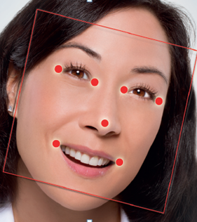
Intel® Perceptual Computing Challenge The $1Million 2013 Application Development Contest*
Focus: Games, Productivity, Creative UI & Multi-modal
Process: Developers submit working prototypes, panel judged
Two Phases:
Phase 1 (CLOSED):
See winners at http://goo.gl/EnNHv
Phase 2: May to August - $800,000+ in prizes
Categories: Perceptual Gaming, Productivity, Creative User Interface and Open Innovation
Available in 16 countries
Enter Phase 2: http://perceptualchallenge.intel.com/
*Terms and Conditions Apply

Slide 10
Call to Action for Developers
Get in on the ‘ground floor’ of this exciting new opportunity.
Bring SDK-enabled apps to market THIS YEAR.
Download the Perceptual Computing SDK
Order the Creative Camera
Enter Stage2 of the Perceptual Computing Challenge
Participate in our Developer Forum
Follow us on Twitter @PerceptualSDK
Create a new world of interactivity
Free download at intel.com/software/perceptual

Slide 12
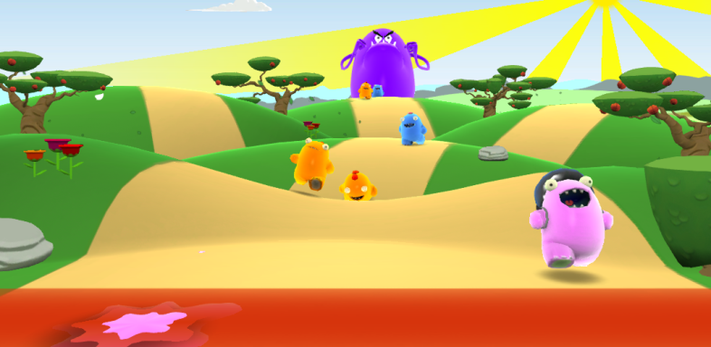
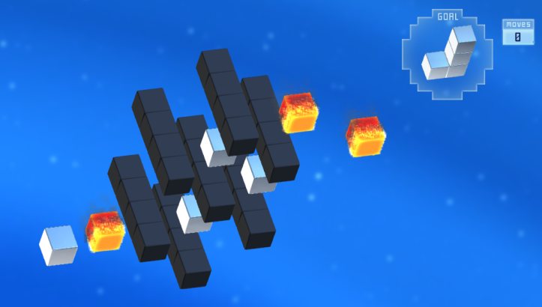
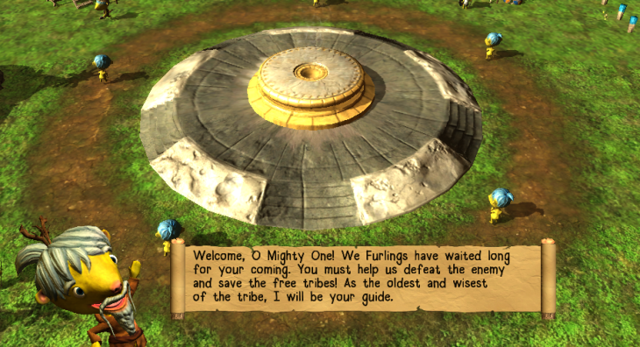
Perceptual Computing Apps: Fun, Interactive, 3D Games
Million Minions*
Kung Pow Kevin*
Squash, flick and toss attacking minions with gestures and poses
Train with a martial arts expert beaver
Aligned*
Idol Hands*
Solve mind-bending 3D puzzles, interacting with gestures & speech
Real time strategy “god” game, build your civilization and rule the world
Control Game Play with Speech, Hands and Fingers!
*Other brands and trademarks may be claimed as the property of their respective owners

Slide 13
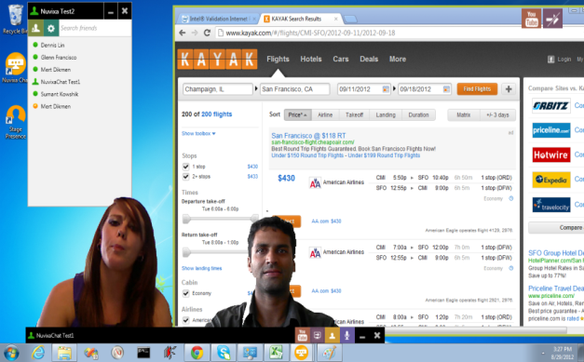
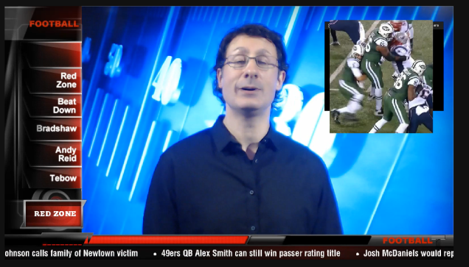
Perceptual Computing Apps: Immersive Video Collaboration and Blogging
Personify*
TouchCast*
Immersive video chat and collaboration - lose the clutter and see what’s important
Create video blogs in minutes – a green screen in your home!
*Other brands and trademarks may be claimed as the property of their respective owners

