Slide 1
Markerless Motion Capture of Interacting Characters Using Multi-view Image Segmentation
Yebin Liu^{1,3}, Carsten Stoll¹, Juergen Gall², Hans-Peter Seidel¹, Christian Theobalt¹
¹MPI Informatik, ²ETH Zurich, ³Tsinghua University

Slide 2
Previous Work
Gall et al. CVPR‘09

Slide 3
Motivation
Existing approaches are limited to a single character

Slide 4
Motivation
Method fails without segmenting the characters

Slide 5
Related Work
Single character
Surface: Starck and Hilton ICCV’03, De Aguiar et al. TOG’08, Varanasi et al. ECCV’08
Surface and skeleton: Vlasic et al. TOG’08, Gall et al. CVPR’09
Skeleton estimation and segmentation with shape prior:
Bray et al. ECCV’06 (graph-cut; inaccurate poses)
Rosenhahn et al. KI’06, Gall et al. CVPR’08, Brox et al. TPAMI’10 (level-set; deterministic 2d prior)
Multiple characters based on visual hull
Cagniart et al. ECCV’10, CVPR’10 (Interaction, but no close interaction; no skeleton)
Guillemaut et al. ICCV’09 (Sport; only rough visual hull)
Egashira et al. ICIAP’09 (Hand shake; no surface; based on skin color blobs)

Slide 6
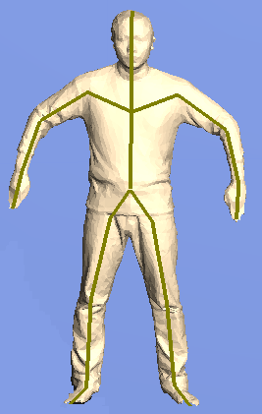
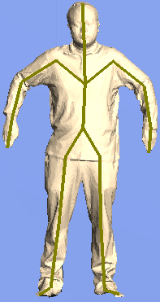
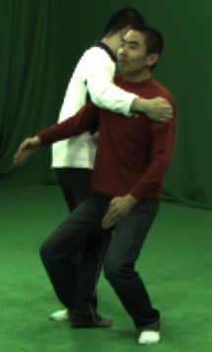
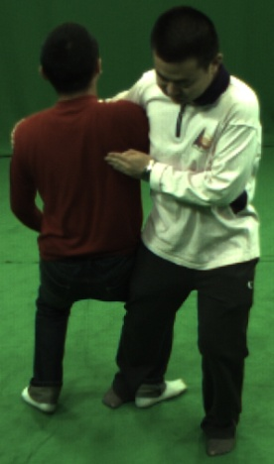
Our approach
Estimate surface deformation (cloth) and skeleton of interacting characters
Graph-cut segmentation with probabilistic shape and appearance model
Fast motions with frequent physical contact
Input:
Initial mesh and skeleton
Multi-view images and silhouettes

Slide 7
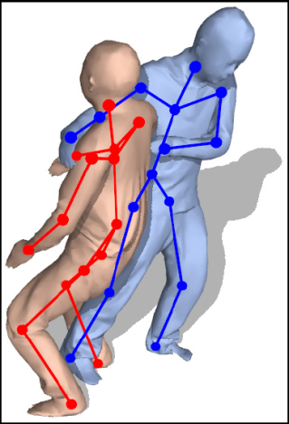
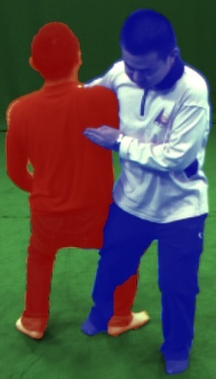
Overview
Previous frame
Images and silhouettes
Image segmentation
Subject A: Estimate skeleton and surface pose based on blue silhouette and contour
Subject B: Estimate skeleton and surface pose based on red silhouette and contour
Current frame
Contour labels

Slide 8
Segmentation
Graph-cut segmentation (Boykov and Jolly ICCV’01, Bray et al. ECCV’06):
Contrast term:
Smoothness prior:
Data term

Slide 9
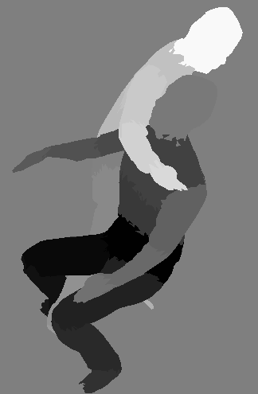
Data term
Data term depends on surface mesh and pose where :
Model color per body part :
Color likelihood
Shape prior

Slide 10
Color likelihood
Color distribution for each body part from first frame
Single appearance model per person
Body part appearance model
Input image

Slide 11
Segmentation with Shape Prior
Input image
Color likelihood
Shape prior

Slide 12
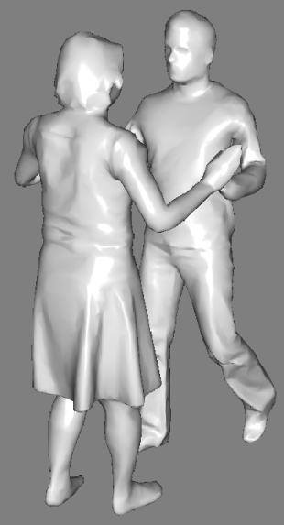
Shape Prior
Modeled in 3d space for both characters:
Surface S from previous frame
Pose prior : Normal distribution
Likelihood term computed over all views: : consistency between projected meshes with foreground silhouettes

Slide 13
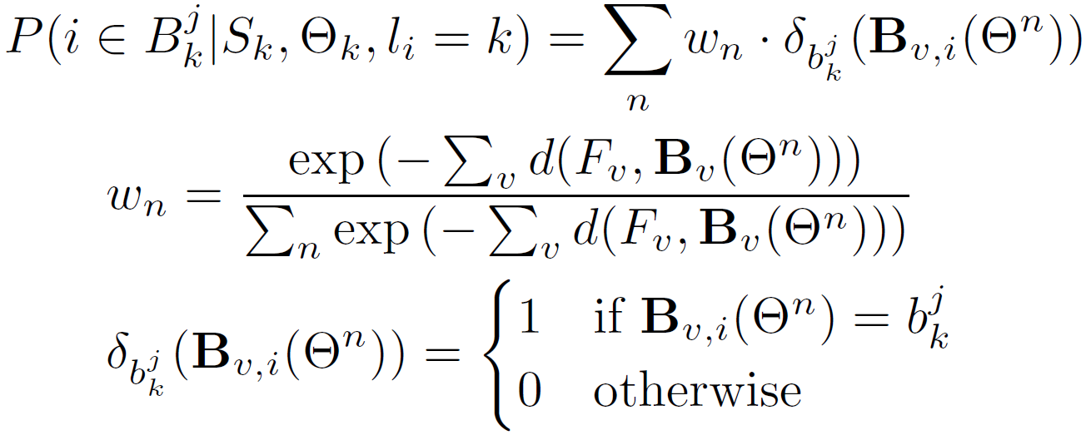
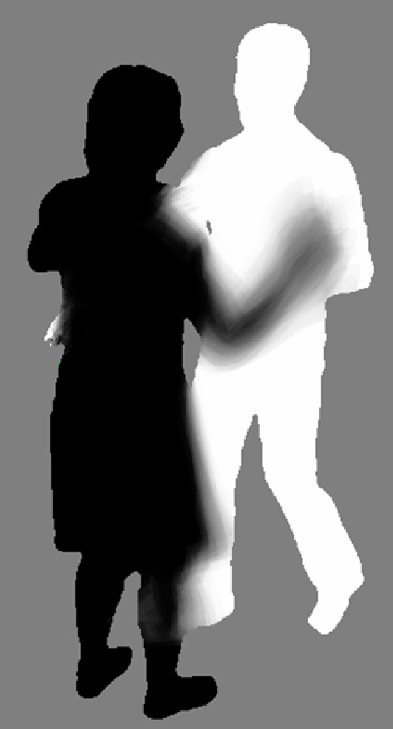
Shape Prior
Approximation by n pose samples :

Slide 14
Comparison
Previous shapes
2d sampling
2d sampling with occlusion
3d sampling

Slide 15
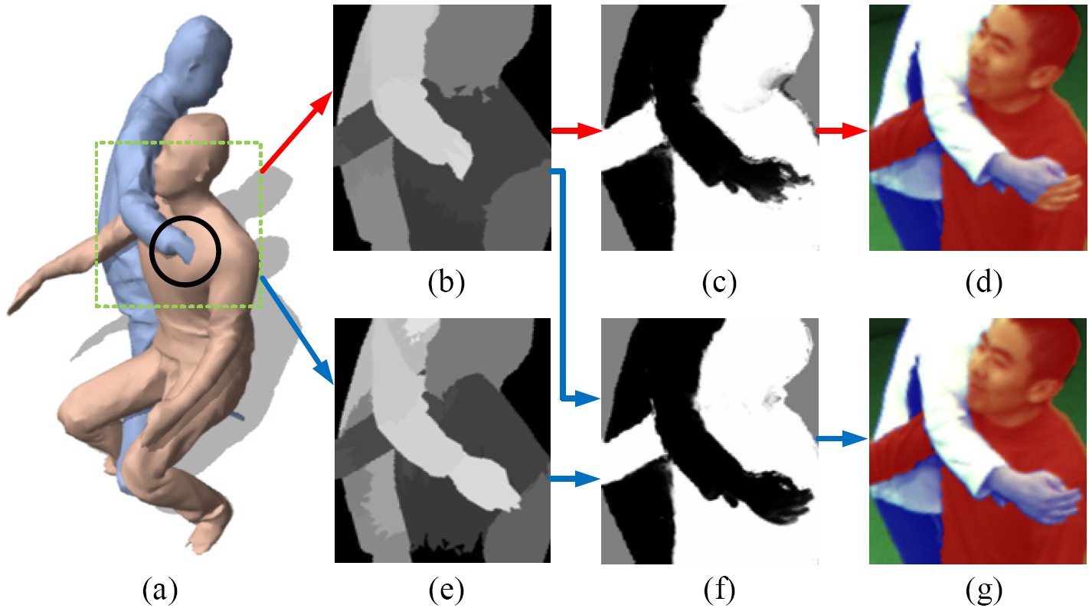
Intersections
80% of the samples have intersections
Efficient rendering approach: normals + inverted normals

Slide 16
Result with Segmentation

Slide 17
Quantitative Evaluation
3d error compared to markers: 30mm

Slide 18
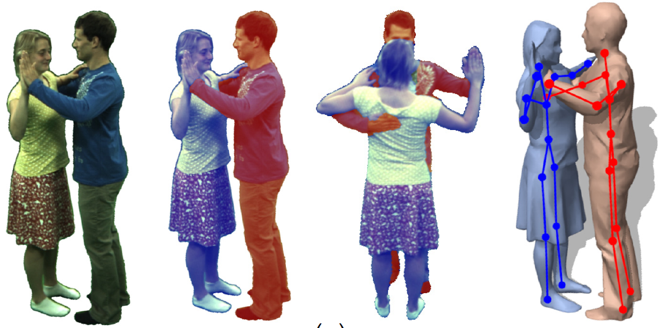
Failure Case

Slide 19
Results

Slide 20
Thank you for your attention.

