Slide 1
What is optical flow for? On prediction, persistence, and structure
Michael J. Black
Max Planck Institute for Intelligent Systems
https://ps.is.tuebingen.mpg.de/person/black
September 14, 2018

Slide 2
Note
This is basically the talk I gave at the ECCV 2018 workshop on “What is optical flow for?”
I’ve removed the videos and replaced them by links to youtube.

Slide 3
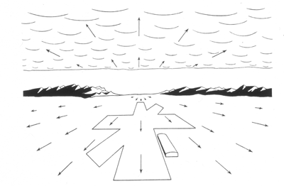
Optical Flow
J. J. Gibson, The Ecological Approach to Visual Perception
Notes:
As an organism moves through the world the pattern of light and dark in the world flows across the optic array. This flow is useful to an organism. It tells you if you are approaching an object, landing, entering a cave, etc.
Gibson however had no notion of computation and was effectively ant-computation.

Slide 4
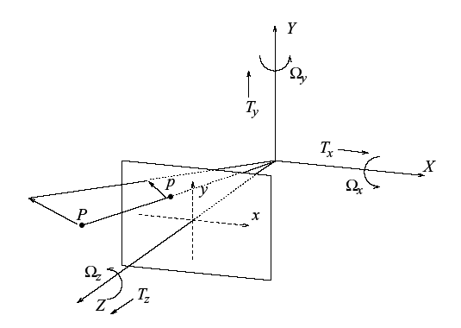
Motion Field
B. Horn, Robot Vision, MIT Press
Motion field = 2D motion field representing the projection of the 3D motion of points in the scene onto the image plane.

Slide 5
Apparent motion
B. Horn, Robot Vision, MIT Press
Optical flow = 2D velocity field describing the apparent motion in the images.

Slide 6
Thought Experiment 1
Lambertian (matte) ball rotating in 3D
What does the 2D motion field look like?
What does the 2D optical flow field look like?
Image source: http://www.evl.uic.edu/aej/488/lecture12.html

Slide 7
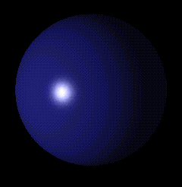
Thought Experiment 2
Stationary Lambertian (matte) ball, moving light source.
What does the 2D motion field look like?
What does the 2D optical flow field look like?
Image source: http://www.evl.uic.edu/aej/488/lecture12.html

Slide 8
Motion field vs Apparent motion
It is important to keep these straight.
They are “for” different problems.
We often confuse them.
But they really need different solutions.

Slide 9
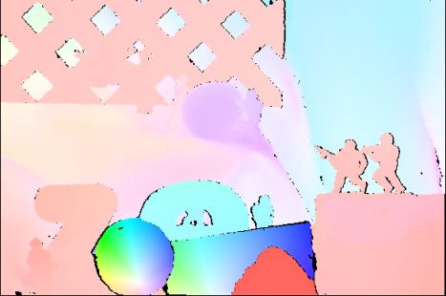
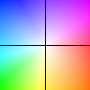
Optical flow
Motion (displacement) of all image pixels
Key
Image pixel value at time t and location x=(x, y)
Horizontal component
Vertical component
Notes:
Color-direction Saturation - magnitude
Intensity-magnitude

Slide 10
Assumption 1
Brightness constancy
Notes:
Explain u and v.

Slide 11
Assumption 2
Spatial coherence
Neighboring pixels in the image are
likely to belong to the same surface.
Surfaces are mostly smooth.
Neighboring pixels will have similar flow.

Slide 12
Assumption 3
Temporal coherence

Slide 13
What I said in my thesis (1992)
Detect object boundaries
Local surface relationships (occlusion/disocclusion)
Segment the scene
Recover observer motion
Detect obstacles
Avoid collision
Recover scene depth
Track moving objects
Distinguish between surface markings and surface boundaries
Extend detection of static image features like edges over time
Robust Incremental Optical Flow
Black, M. J.
http://files.is.tue.mpg.de/black/papers/thesis.pdf

Slide 14
So what is it for?
Rephrase: for what is it useful?

Slide 15
Engineering perspective

Slide 16
MPEG
Motion coding based on block matching

Slide 17
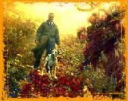
Painterly effect
Impressionist effect.
Transfer motion of real world to a painting.
Academy award.

Slide 18
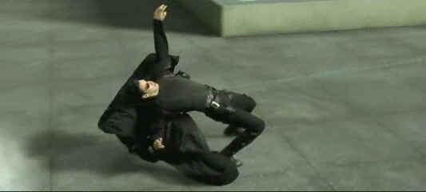
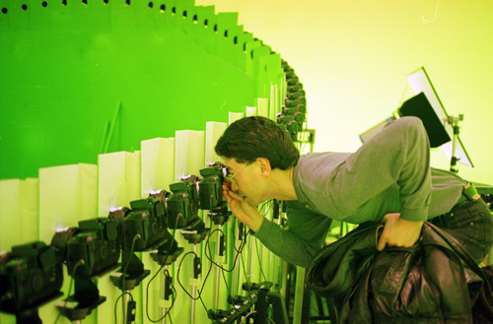
Bullet Time
Use optical flow to compute correspondence between different camera views. Allows smooth interpolation between views.

Slide 19
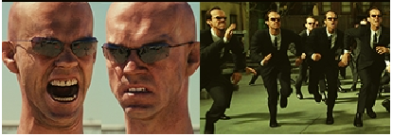
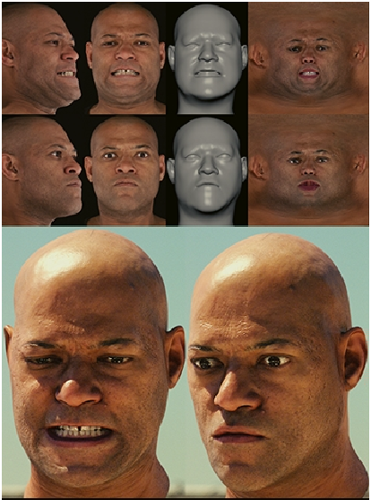
Matrix Reloaded
SIGGRAPH’03

Slide 20
Facial expressions
Bassili, J.N. 1979. Emotion recognition: The role of facial movement and the relative importance of upper and lower areas of the face. Journal of Personality and Social Psychology, 37:2049– 2059

Slide 21
Facial expressions
Recognizing facial expressions in image sequences using local parameterized models of image motion
Black, M. J., Yacoob, Y.
Int. Journal of Computer Vision, 25(1):23-48, 1997
https://youtu.be/ZnCiZWNnNC4

Slide 22
Recognizing speech from optical flow
Black, M. J.
Black, M. J.
https://youtu.be/omnKARu5HfI
Black, Explaining optical flow events with parameterized spatio-temporal models, CVPR’99, pages: 326-332, 1999

Slide 23
Scientific perspective

Slide 24
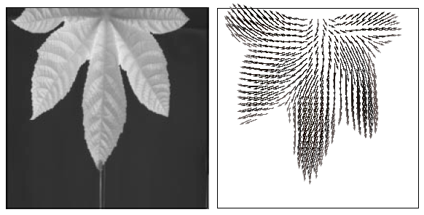
Scientific Applications
Tensor-based Image Sequence Processing Techniques for the Study of Dynamical Processes, Haussecker, Spies, and Jahne, Proc. Intern. Symp. On Real-time Imaging and Dynamic Analysis: 704-711, 1998

Slide 25
Heart motion
Magnetic resonance imaging Full Access
Bandpass optical flow for tagged MRI
Jerry L. Prince
Sandeep N. Gupta
Nael F. Osman
First published: 06 January 2000
Evaluation of cardiac left ventricular mass from Tagged Magnetic Resonance Imaging
Abram W. Makram, Ayman M. Khalifa, +3 authors El-Sayed H. Ibrahim 2014 Cairo International Biomedical Engineering…

Slide 26
Connectomics
Frame 1
Frame 11
Jurrus E, Tasdizen T, Koshevoy P, et al. Axon Tracking in Serial Block-Face Scanning Electron Microscopy. Medical image analysis. 2009;13(1):180-188. doi:10.1016/j.media.2008.05.002.

Slide 27
Cell motility
Boric K, Orio P, Viéville T, Whitlock K. Quantitative Analysis of Cell Migration Using Optical Flow. Key B, ed. PLoS ONE. 2013;8(7):e69574. doi:10.1371/journal.pone.0069574.

Slide 28
Meteorological applications
Caren Marzban and Scott Sandgathe
Optical Flow for Verification, Weather and Forecasting, Volume 25 No. 5, October 2010

Slide 29
What is the common thread?
Some appearance information is conserved between frames.
There is some sort of smooth spatial structure that can be approximated.
Something persists over time (frames) in a predictable way.

Slide 30
Neuroscience perspective

Slide 31
We are prediction machines

Slide 32
We are prediction machines

Slide 33
We are prediction machines

Slide 35
We are explaining/organizing machines
We want simple explanations rather than complex ones

Slide 37
Motion and Brains
So there are direction selective cells in V1.
How does this arise?
Does it mean that the brain computes flow?

Slide 38
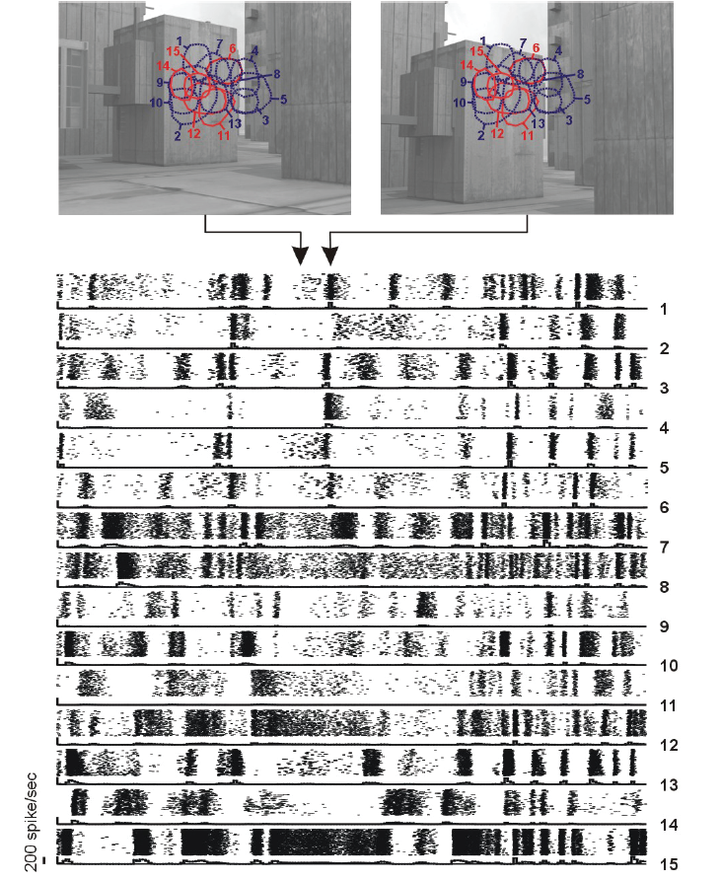
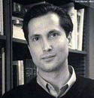
Jose-Manuel Alonso
Garrett Stanley

Slide 39
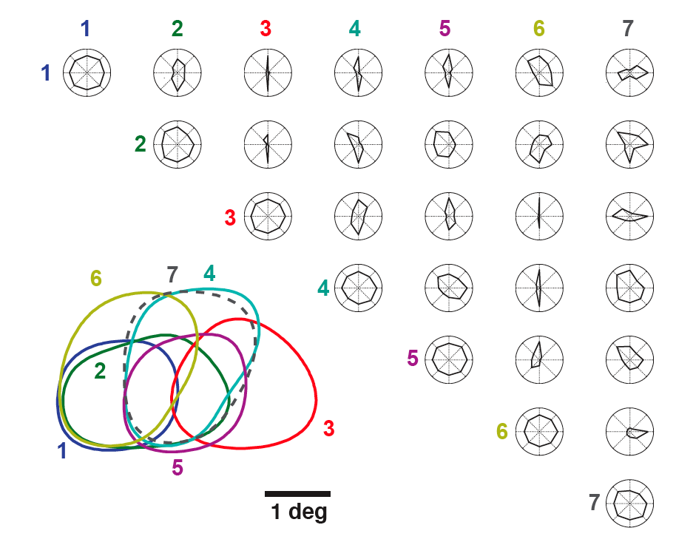
Synchronous firing in LGN
Stanley, Jin, Wang, Desbordes, Wang, Black, M., Alonso, Visual Orientation and Directional Selectivity Through Thalamic Synchrony, J. Neuroscience, 32(26):9073-9088, June 2012
Individual LGN cells do not exhibit directional tuning.
Classic.
Solid=On cells, Dashed=Off cells

Slide 40
Synchronous firing in LGN
Stanley, Jin, Wang, Desbordes, Wang, Black, M., Alonso, Visual Orientation and Directional Selectivity Through Thalamic Synchrony, J. Neuroscience, 32(26):9073-9088, June 2012
Synchronous activity of pairs of cells show strong directional tuning.
Even for overlapping receptive fields.
Solid=On cells, Dashed=Off cells

Slide 41
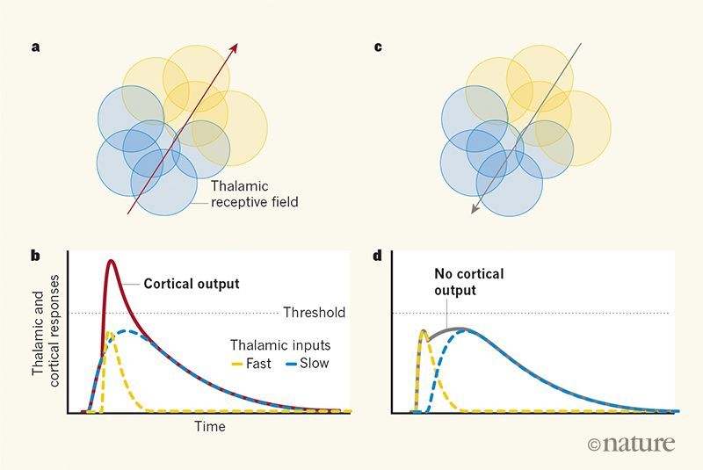
LGN-V1
Overlapping RF in LGN may project to same cortical neuron
When they fire together, they are likely to stimulate V1 neuron
Differences in LGN responses of overlapping RFs can encode motion
Cortical direction selectivity emerges at convergence of thalamic synapses
Anthony D. Lien & Massimo Scanziani
Nature volume 558, pages 80–86 (2018)

Slide 42
My perspective

Slide 43
Why optical flow?
Flow is about persistence, prediction and structure.
We are faced with a constantly changing retinal (image plane) image.
We have to efficiently establish what is persistent and what is changing.
The persistent and the changing are both critical to survival.

Slide 44
This video shows really old work from my thesis.
I showed it for several reasons:
The random noise sequence shows how movement, without other cues, provides information about the structure of the world.
I particular it can tell us about occlusion and disocclusion
https://youtu.be/bpd1FWUwlYo
Black, M. J., Anandan, P., Robust dynamic motion estimation over time, CVPR-91, pages: 296-302, 1991

Slide 45
Discontinuities
“location of these discontinuities in the flow field correspond to physically significant properties of the scene, they can be used to detect object boundaries or segment the scene into distinct objects”

Slide 46
Temporal coherence
What is coherent over time?
Not flow!
A camera jitter and rotation (or saccades) cause rapid change in flow
What is persistent is
3D structure of the world
Integrity of 3D objects
Temporal consistency is a property of the world, not of optical flow.

Slide 47
Spatial and temporal coherence of structure
Layer segments
Flow field
Layered models combine flow and image evidence to segment the scene.
Provide a depth ordering.
The structure (segmentation) persists over time, while the flow may vary a lot.
Enforce strong constraints on structural coherence over time
Layered segmentation and optical flow estimation over time
Sun, D., Sudderth, E., Black, M. J.
CVRP 2012
https://ps.is.tuebingen.mpg.de/research_projects/layered-optical-flow

Slide 48
Coherence of 3D scenes (MR Flow)
Wulff, J., Sevilla-Lara, L., Black, M. J., Optical Flow in Mostly Rigid Scenes, CVPR 2017
https://ps.is.tuebingen.mpg.de/research_projects/optical-flow-for-mostly-rigid-scenes

Slide 49
Semantic optical flow
https://ps.is.tuebingen.mpg.de/research_projects/semantic-optical-flow
sky
unknown
building
car
grass
road
Motion is not arbitrary. Motion and meaning are coupled.
Optical Flow with Semantic Segmentation and Localized Layers
Sevilla-Lara, L., Sun, D., Jampani, V., Black, M. J., CVPR 2016

Slide 50
Semantic optical flow
https://ps.is.tuebingen.mpg.de/research_projects/semantic-optical-flow
https://youtu.be/QwmBSTWgr_s
Motion is not arbitrary. Motion and meaning are coupled.
Optical Flow with Semantic Segmentation and Localized Layers
Sevilla-Lara, L., Sun, D., Jampani, V., Black, M. J., CVPR 2016

Slide 51
Learning optical flow
Shallow convolution model (Field of Experts)
Sun, D., Roth, S., Lewis, J., Black, M. J.,
Learning Optical Flow, ECCV 2008
Roth, S., Black, M. J., On the spatial statistics of optical flow
IJCV, 74(1):33-50, 2007
http://files.is.tue.mpg.de/black/papers/SunECCV08.pdf
http://files.is.tue.mpg.de/black/papers/iccv05roth.pdf

Slide 52
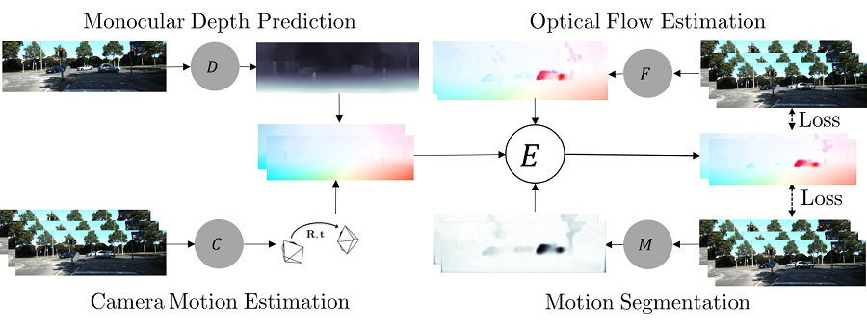
Learning optical flow (unsupervised)
https://ps.is.tuebingen.mpg.de/uploads_file/attachment/attachment/432/ac.pdf
Ranjan, A., Jampani, V., Kim, K., Sun, D., Wulff, J., Black, M. J., Adversarial Competitive Collaboration: Joint Unsupervised Learning of Depth, Camera Motion, Optical Flow and Motion Segmentation, arXiv 2018

Slide 53
So what is flow for?
Flow (apparent motion), is useful for tons of things in many fields
It is about finding what is constant between images
Flow (motion field), is useful for understanding the structure of the 3D world
But it can be an artifact of something deeper
What matters is the contuity of perception

Slide 54
What is optical flow for?
Establishing what goes with what in space and time

Slide 55
What is optical flow the result of?
Establishing what goes with what in space and time

Slide 56
What is optical flow the result of?
Establishing what goes with what in space and time
Optical flow is as much the output of coherence and persistence as the input.
It may not be a fundamental representation in and of itself.
Rather it is the fundamental result of temporal coherence.
It is the observable trace left by making sense of a changing world.

Slide 57
”Take home” message
We often talk about “optical flow” as one thing.
We should acknowledge that the motion field and the apparent motion are different
Different constraints are useful and needed
Different training data should be used
The applications are very different
Many uses of apparent motion in science, medicine, engineering
An algorithm that does well on KITTI may not give good flow for these problems and vice versa
Developing different flow methods for different problems is valuable
Not every algorithm has to do well on Sintel and KITTI to be useful

