Slide 1
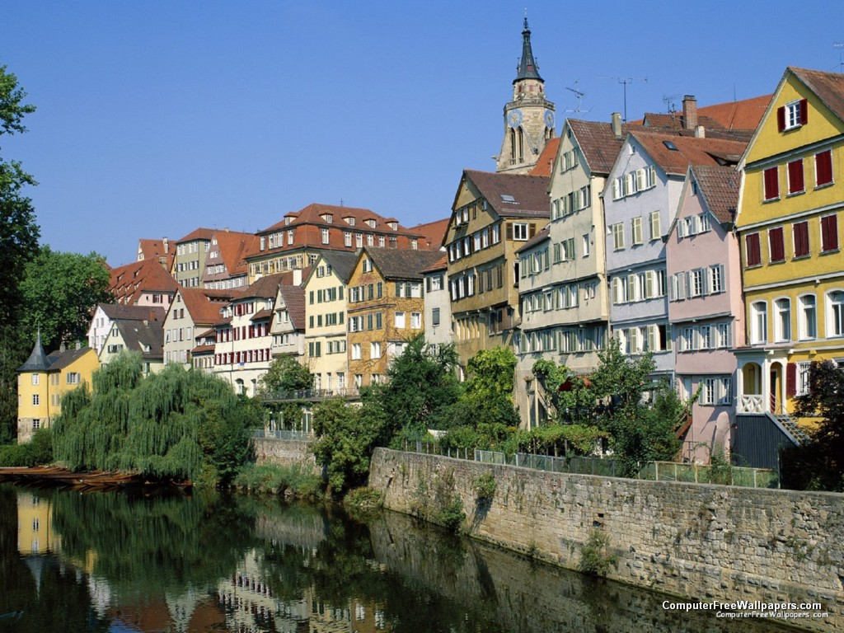

Computing Optical Flow
The “good parts” version
Michael J. Black
Max Planck Institute for Intelligent Systems
Perceiving Systems Department
Tübingen, Germany

Slide 2
Goals
Introduce optical flow
You should have a sense of the state of the art
You should know where things still break and why
You should walk away with code
You should get some ideas of where ML can play a role

Slide 3
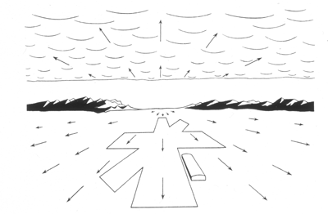
Optical Flow
J. J. Gibson, The Ecological Approach to Visual Perception
Notes:
As an organism moves through the world the pattern of light and dark in the world flows across the optic array. This flow is useful to an organism. It tells you if you are approaching an object, landing, entering a cave, etc.
Gibson however had no notion of computation and was effectively ant-computation.

Slide 4
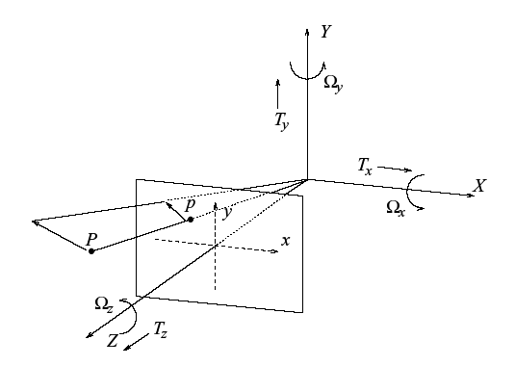
Motion Field
Motion field = 2D motion field representing the projection of the 3D motion of points in the scene onto the image plane.

Slide 5
Optical Flow
Optical flow = 2D velocity field describing the apparent motion in the images.

Slide 6
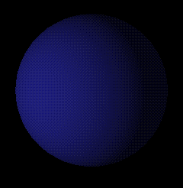
Thought Experiment 1
Lambertian (matte) ball rotating in 3D
What does the 2D motion field look like?
What does the 2D optical flow field look like?
Image source: http://www.evl.uic.edu/aej/488/lecture12.html

Slide 7
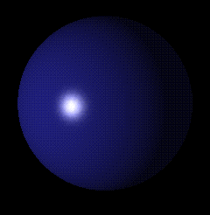
Thought Experiment 2
Stationary Lambertian (matte) ball, moving light source.
What does the 2D motion field look like?
What does the 2D optical flow field look like?
Image source: http://www.evl.uic.edu/aej/488/lecture12.html

Slide 8
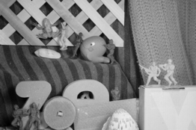
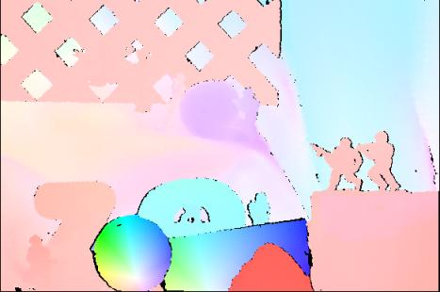
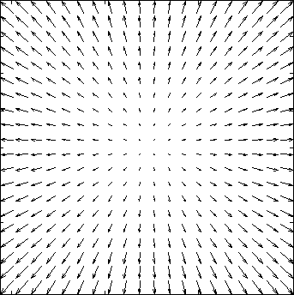
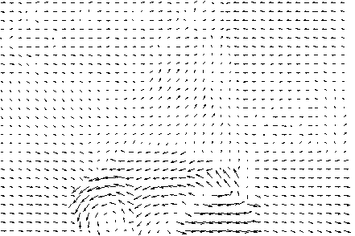
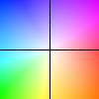
Optical flow
Motion (displacement) of all image pixels
Key
Image pixel value at time t and location x=(x, y)
Horizontal component
Vertical component
Notes:
Color-direction Saturation - magnitude
Intensity-magnitude

Slide 9
An aside
We are intentionally forgetting any physics we might know.
We will deal with images, not surfaces, materials, light, and optics.
We’ll hope that the 2D flow is related to the structure of the world and can substitute for the motion field.
Fixing the above is important. But not today.

Slide 10
Traditional applications
Dense structure from motion
  don’t really know how to recover structure with multiple, non-rigid, independently moving objects
Estimation of camera motion
  you can do this by tracking a few feature points
Detection of surface boundaries
  the boundaries are exactly where most flow algorithms fail

Slide 11
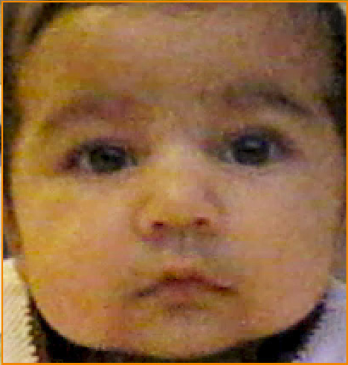
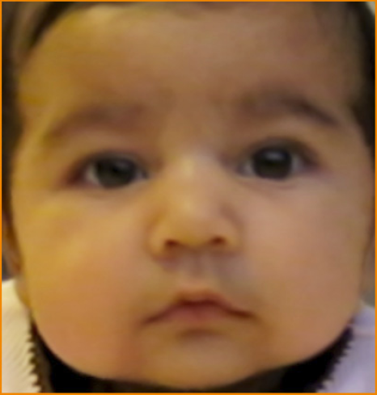
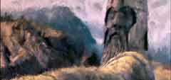
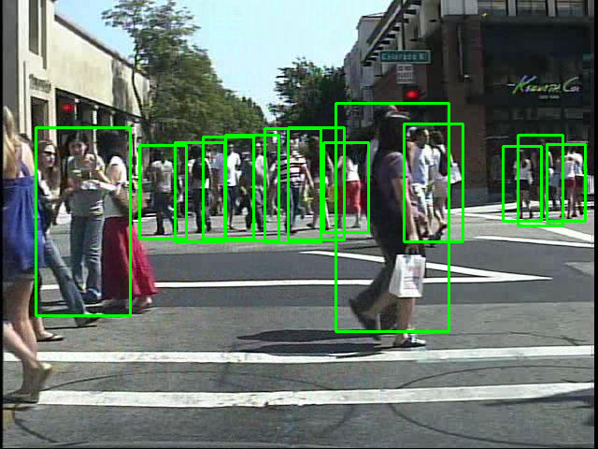
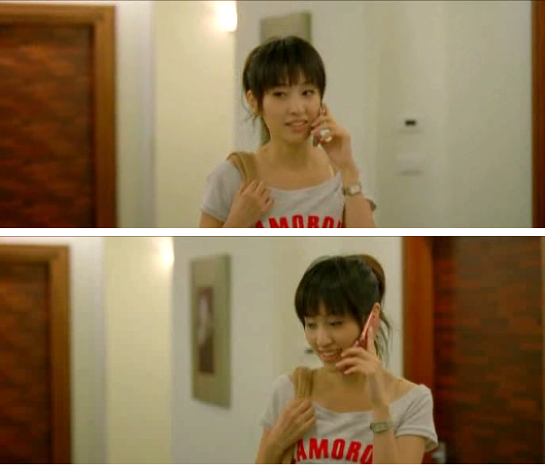
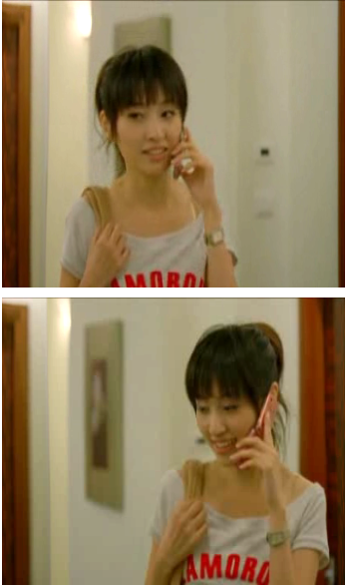
Recent applications
Image processing
Computer Graphics
Games
Plant growth
Biology: cell motion, heart wall motion, …
Ocean currents, Meteorology, …
Particle image velocimetry, …
…
[Hays & Essa 2004]
[Liu & Freeman 2010]
[Walk et al. 2010]
[Wang et al. 2010]
Video denoising
Video super resolution
Video compression
Pedestrian detection
…
Painterly animation
Motion magnification
Video retargeting
…

Slide 12
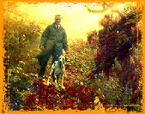
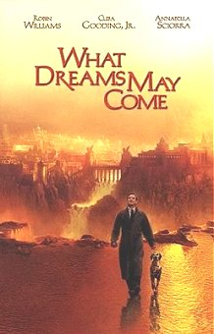
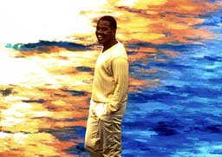
Painterly effect
Impressionist effect.
Transfer motion of real world to a painting.
Academy award.

Slide 13
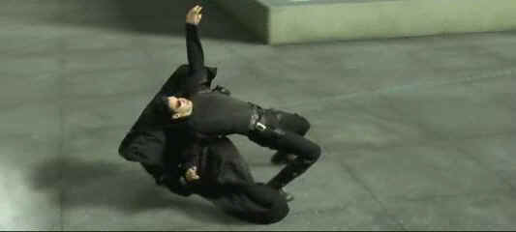
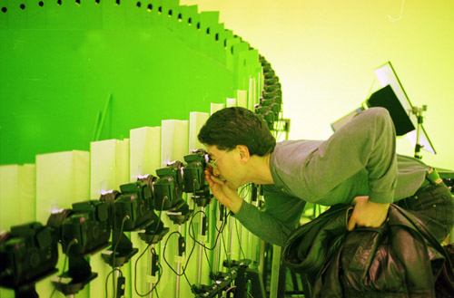
Bullet Time
Use optical flow to compute correspondence between different camera views. Allows smooth interpolation between views.

Slide 14
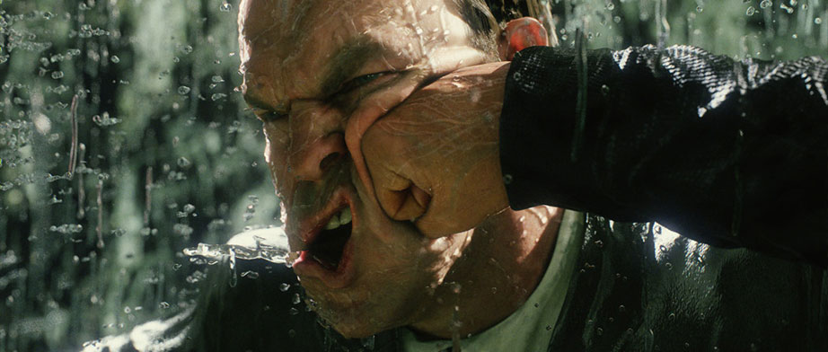
Matrix Reloaded
Extend flow to 3D meshes. Allows realistic deformation of faces in slow motion.

Slide 15
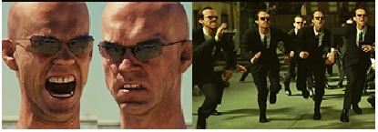
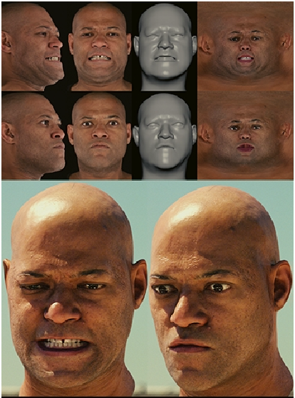
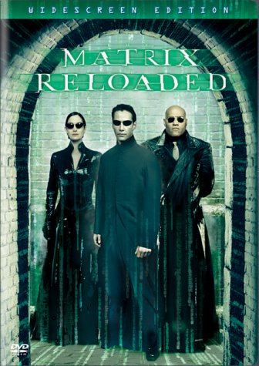
Matrix Reloaded
SIGGRAPH’03

Slide 16

Goal
The apparent 2D image motion of pixels from one image frame to the next in a video sequence.
Notes:
Implementation details: not for speed of a method. There is no publicly available source code for state-of-the-art methods. It is hard to reproduce the results reported in a paper, because many details are briefly described or even omitted in the (conference) papers.

Slide 17
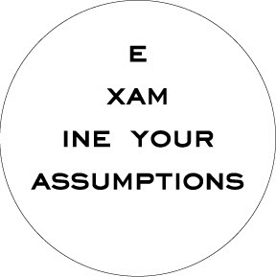




Goal
Step 1
Step 2
Step 3
Step 4
Formalization
Objective
function
Optimization
method
Implementation
details
Assumptions
Evaluation
Notes:
Implementation details: not for speed of a method. There is no publicly available source code for state-of-the-art methods. It is hard to reproduce the results reported in a paper, because many details are briefly described or even omitted in the (conference) papers.

Slide 18
Goal
Step 1
Assumptions
Notes:
Implementation details: not for speed of a method. There is no publicly available source code for state-of-the-art methods. It is hard to reproduce the results reported in a paper, because many details are briefly described or even omitted in the (conference) papers.

Slide 19
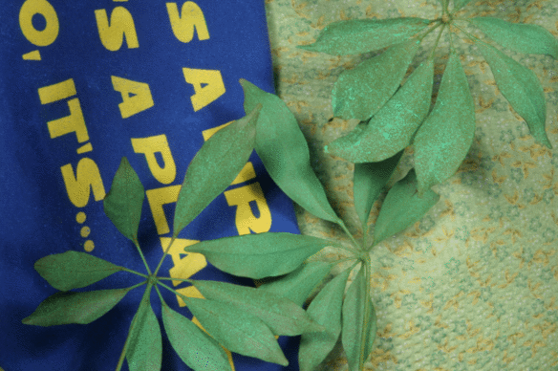




Assumption 1
Brightness constancy
Notes:
Explain u and v.

Slide 20
Assumption 1
Brightness constancy
Notes:
Explain u and v.

Slide 21
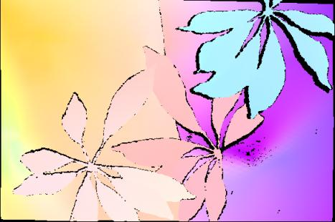
Assumption 2
Spatial smoothness
Neighboring pixels in the image are
likely to belong to the same surface.
Surfaces are mostly smooth.
Neighboring pixels will have similar flow.

Slide 22
Assumption 2
Spatial smoothness
ie, spatial derivative is zero

Slide 23
Goal
Step 1
Step 2
Formalization
Objective
function
Assumptions
Notes:
Implementation details: not for speed of a method. There is no publicly available source code for state-of-the-art methods. It is hard to reproduce the results reported in a paper, because many details are briefly described or even omitted in the (conference) papers.

Slide 24
Objective function
Brightness constancy
New assumption:
Quadratic error function implies Gaussian noise.

Slide 25
Objective function
New assumptions:
Flow field is smooth
Deviations from smooth are Gaussian
First order smoothness is all that matters
Flow derivative is approximated by first differences.

Slide 26
Objective function
relative weighting term

Slide 27
Let’s solve for flow
Problem: Not linear in the flow. Makes optimization difficult.

Slide 28
Linear approximation

Slide 29
Linear approximation

Slide 30
Optical flow constraint equation
New assumptions:
Flow is small.
Image is a differentiable function.
First order Taylor series is a good approximation.

Slide 31
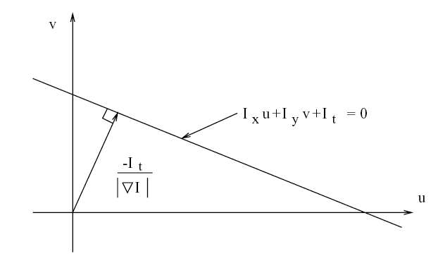
OFCE (ill-posed problem)
At a single image pixel, we get a line:
“Normal flow”

Slide 32

Ambiguous motion cue
Aperture problem

Slide 33
Ambiguous motion cue
Aperture problem

Slide 34
Ambiguous motion cue
Aperture problem

Slide 35
Ambiguous motion cue
Normal velocity (perpendicular to edge)

Slide 36
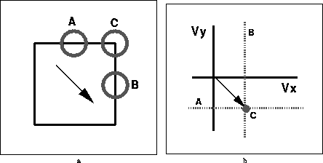
Multiple constraints
v
u
What are the constraint lines?
Yair Weiss

Slide 37
Multiple constraints
v
u
Combine constraints to get an estimate of velocity.
Yair Weiss

Slide 38
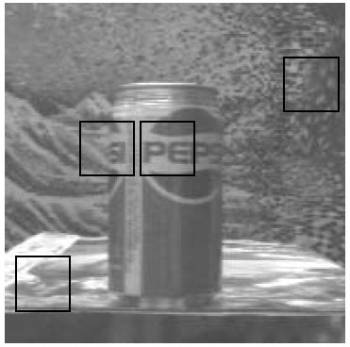
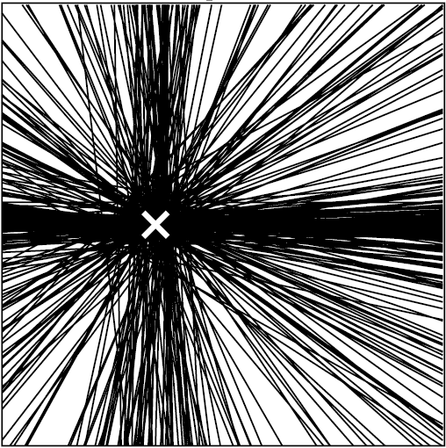
Multiple Constraints
v
u
Each pixel gives us a constraint:

Slide 39
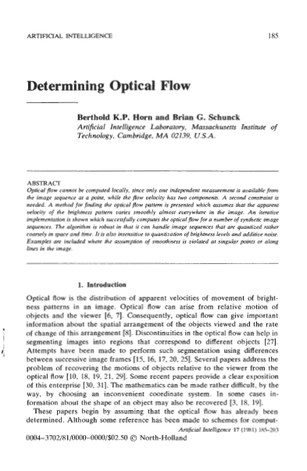
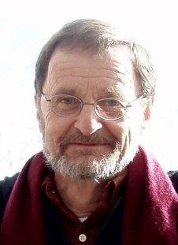
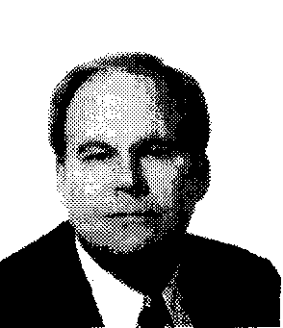
Horn and Schunck ‘81
Horn
Schunck

Slide 40
Goal
Step 1
Step 2
Step 3
Formalization
Objective
function
Optimization
method
Assumptions
Notes:
Implementation details: not for speed of a method. There is no publicly available source code for state-of-the-art methods. It is hard to reproduce the results reported in a paper, because many details are briefly described or even omitted in the (conference) papers.

Slide 41
Minimization

Slide 42
Minimization
Linear equations in the flow fields
Rearrange terms
u
u
+
=
v
v

Slide 43
Minimization
A is large but sparse. Easy to solve for flow x.

Slide 44
Horn and Schunck
“We now have a pair of equations for each point in the image. It would be very costly to solve these equations simultaneously by one of the standard methods, such as Gauss-Jordan elimination.”
Step 4
So they used a really bad iterative optimization method.
Implementation
details

Slide 45
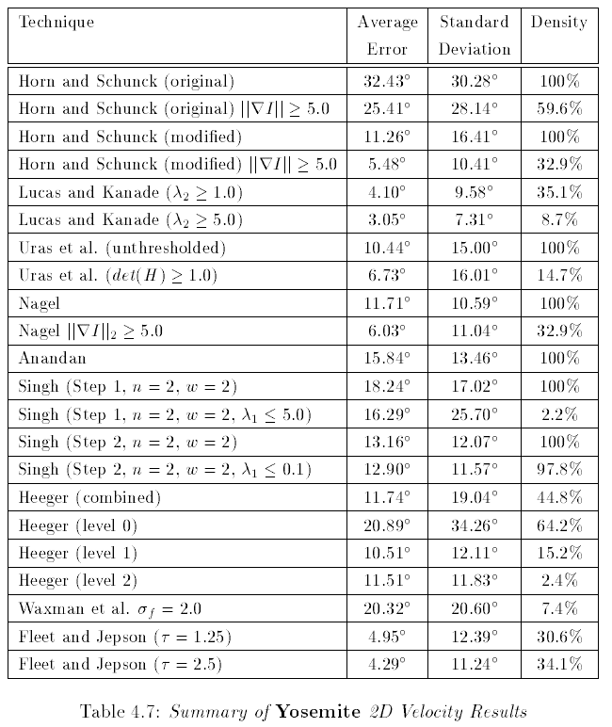
Barron, Fleet, Beauchemin,
Performance of optical flow techniques,
IJCV, 1994

Slide 46
Assumption Review
Brightness is constant
Deviations from constancy are Gaussian
Motion is small (<1 pixel)
First-order Taylor series is a good approximation
Image is differentiable
Flow field is smooth
Deviations from smooth are Gaussian
First order smoothness is all that matters
Flow derivative is approximated by first differences.

Slide 47
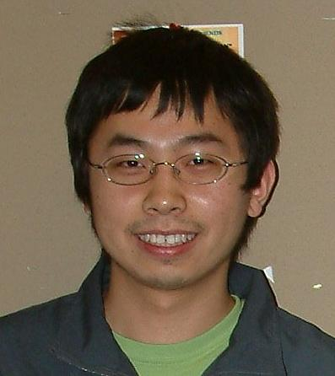

Path forward
Can we figure out which assumptions are problematic and improve them?
Can we improve the optimization?
We can systematically pick off one issue after another.
Deqing Sun
Stefan Roth

Slide 48
Assumption Review
Brightness is constant
Deviations from constancy are Gaussian
Motion is small (<1 pixel)
First-order Taylor series is a good approximation
Image is differentiable
Flow field is smooth
Deviations from smooth are Gaussian
First order smoothness is all that matters
Flow derivative is approximated by first differences.

Slide 49
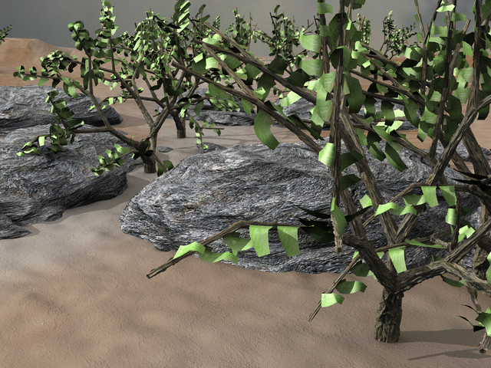
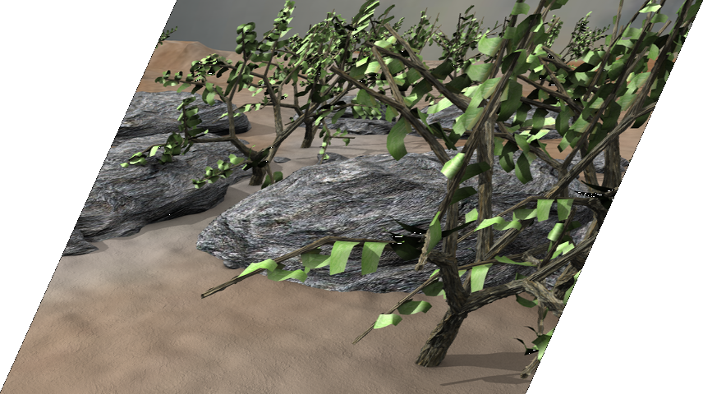
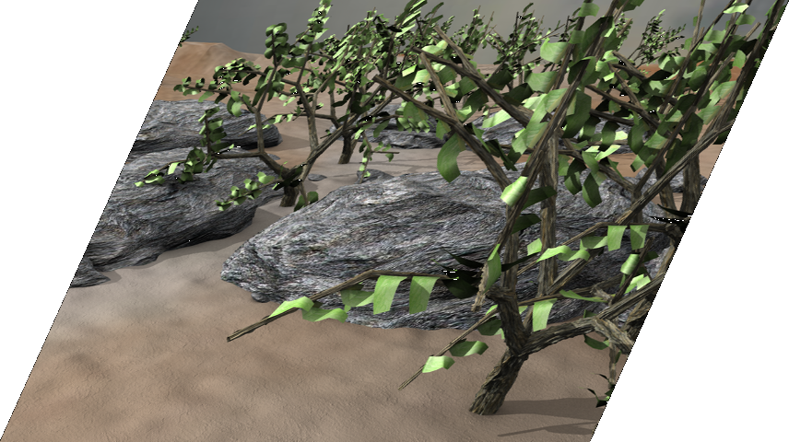


Coarse-to-fine Estimation
Bergen et al. 1992
|u|= 1.25 pixels
|u|= 2.5 pixels
|u|= 5 pixels
|u|= 10 pixels
$$I_{1}$$
$$I_{2}$$

Slide 50




Coarse-to-fine Estimation
Bergen et al. 1992
refine
warp
$$∆w^{k}$$
$$w^{k}$$
+
$${\hat{w}}^{k}$$
$$w^{k+1}$$
$$I_{1}$$
$$I_{2}$$

Slide 51
Coarse-to-fine Estimation
Bergen et al. 1992
refine
warp
$$∆w^{k}$$
$$w^{k}$$
+
$${\hat{w}}^{k}$$
$$w^{k+1}$$
Motions are small at each level.
First order Taylor series is fine.
Warping function must be defined.
$$I_{1}$$
$$I_{2}$$

Slide 52
Asymmetric Pyramid
Sun, Roth, Black. 2013
refine
warp
$$∆w^{k}$$
$$w^{k}$$
+
$${\hat{w}}^{k}$$
$$w^{k+1}$$
For wide screen movies, use different downsampling in horizontal and vertical direction.
Makes a big difference.
$$I_{1}$$
$$I_{2}$$

Slide 53
Assumption Review
Brightness is constant
Deviations from constancy are Gaussian
Motion is small (<1 pixel)
First-order Taylor series is a good approximation
Image is differentiable (use good filters)
Flow field is smooth
Deviations from smooth are Gaussian
First order smoothness is all that matters
Flow derivative is approximated by first differences.

Slide 54
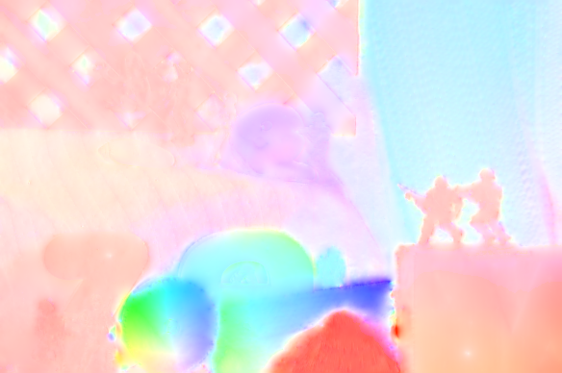
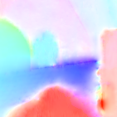
Optical flow
Motion (displacement) of image pixels
Horn & Schunck
Key
Notes:
Color-direction Saturation - magnitude
Intensity-magnitude

Slide 55
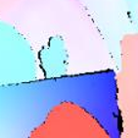
Optical flow
Motion (displacement) of image pixels
Ground Truth
Horn & Schunck
Key
Notes:
Color-direction Saturation - magnitude
Intensity-magnitude

Slide 56
Optical flow
Our objective function is the negative log of the probabilistic formulation
“Army”
Horn & Schunck 1981
Key
Classical model:
Flow field
Likelihood (“data” term)
Prior
(“spatial” term)
Notes:
Color-direction Saturation - magnitude
Intensity-magnitude

Slide 57
The revenge of Horn and Schunck
(same objective function optimized and implemented with modern methods by Deqing Sun)

Slide 58

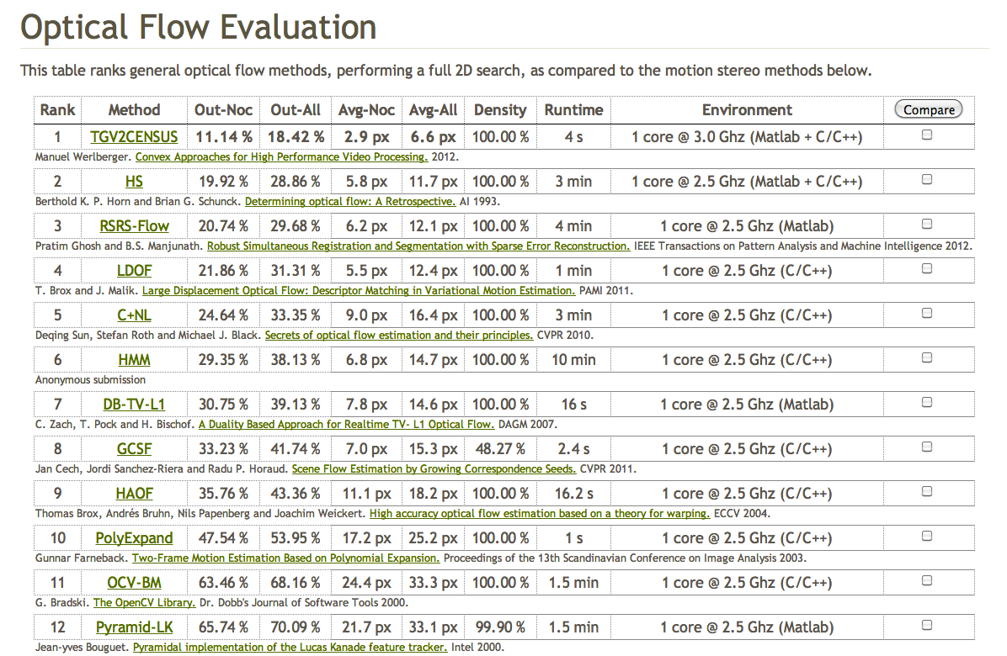
http://www.cvlibs.net/datasets/kitti/eval_stereo_flow.php?benchmark=flow

Slide 59
Assumption Review
Brightness is constant – ?
Deviations from constancy are Gaussian – ?
Motion is small (<1 pixel)
First-order Taylor series is a good approximation
Image is differentiable (use good filters)
Flow field is smooth
Deviations from smooth are Gaussian
First order smoothness is all that matters
Flow derivative is approximated by first differences.

Slide 60
Need a “ground truth” to understand these
(i.e. training data)

Slide 61


Slide 62
Problems
small motions (<12 ppf or <35ppf)
short clips (2-8 frames)
limited complexity
  current methods get similar performance
limited data prevents machine learning
image resolution is low (still NTSC)
no motion blur and infinite depth of field
no atmospheric effects
simple lighting

Slide 63
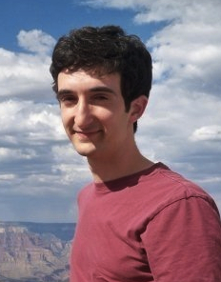

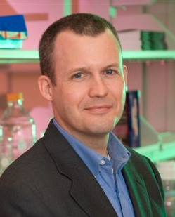
A naturalistic open source movie for optical flow evaluation
Butler, D.J., Wulff, J., Stanley, G.B. and Black, M.J.
ECCV 2012.
Dan Butler, Univ. of Washington
Jonas Wulff, Max Planck
Garrett Stanley, Georgia Tech

Slide 64
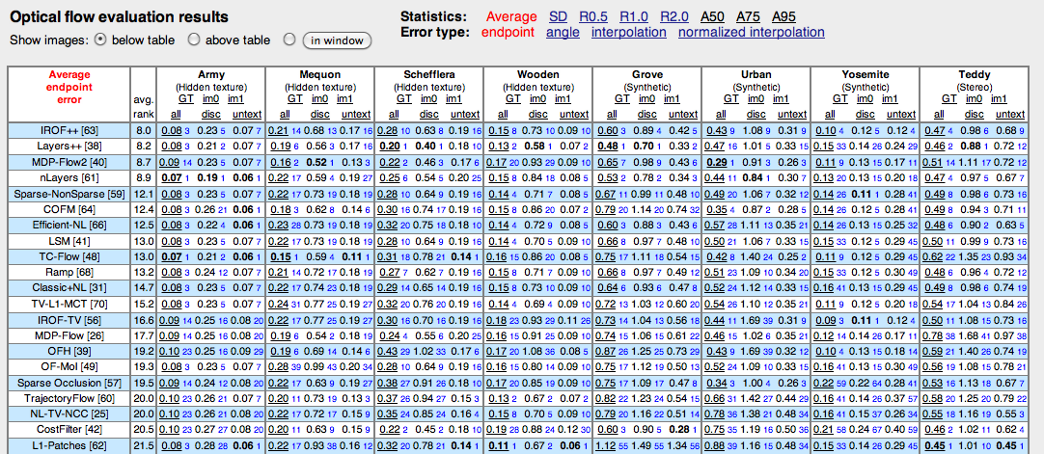
Evaluation is key
Middlebury – 70 current methods evaluated.

Slide 66

Sintel
Durian Open Source Movie Project, Blender Foundation
All graphics available
Extract ground truth
Large motions
Long sequences
“Naturalistic”
Fully in our control

Slide 68
Dataset
1628 frames of ground truth flow
1024x436 (similar in height to existing)
200x more pixels than Middlebury
most clips are 50 frames with 49 gt flows
max velocity well over 100 ppf
Separated into training and test
  test set withheld (~400 frames)
  test set contains some clips from scenes in training and some not in training

Slide 69
Problem
Can an animated movie teach us about optical flow in the real world?
Will results generalize?
Is it realistic enough?
Solution: compare Sintel statistics with those of real scenes.
How?

Slide 70
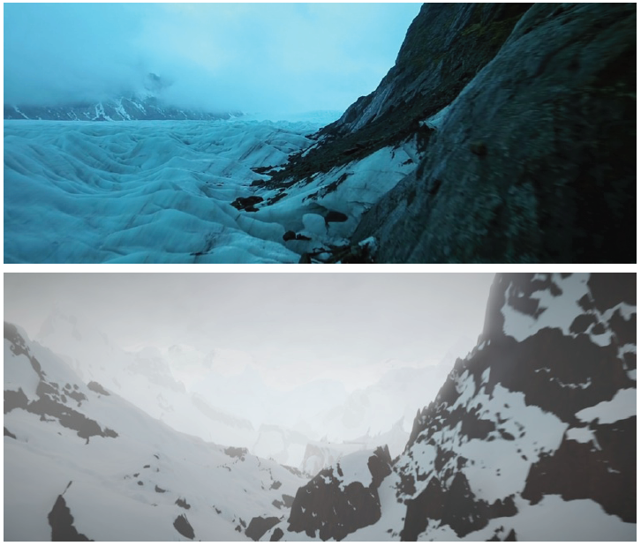
Idea: Lookalikes
Lookalikes are “real” scenes that are semantically similar to Sintel scenes.
lookalike
Sintel

Slide 71
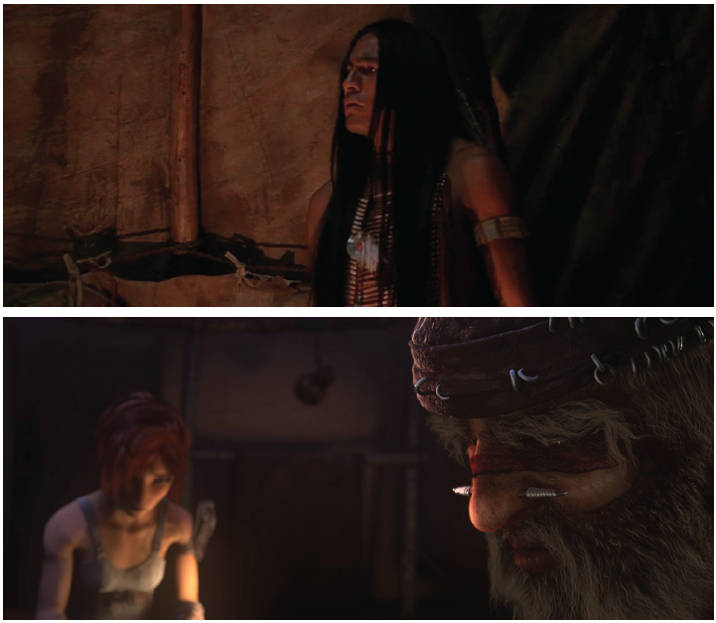
Idea: Lookalikes
Lookalikes are “real” scenes that are semantically similar to Sintel scenes.
lookalike
Sintel

Slide 72
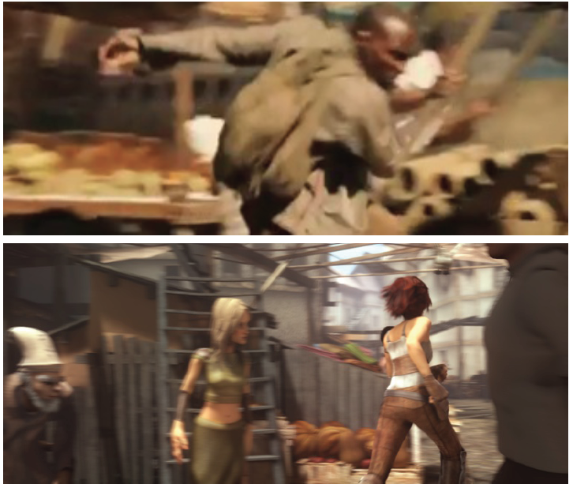
Idea: Lookalikes
Lookalikes are “real” scenes that are semantically similar to Sintel scenes.
lookalike
Sintel

Slide 73

Idea: Lookalikes
Lookalikes are “real” scenes that are semantically similar to Sintel scenes.
lookalike
Sintel

Slide 74

Idea: Lookalikes
Lookalikes are “real” scenes that are semantically similar to Sintel scenes.
lookalike
Sintel

Slide 76
Lookalike statistics
Do Sintel scenes resemble natural scenes?
  Here we look at image statistics

Slide 77



Luminance and power

Slide 78

Marginal image derivative statistics

Slide 79
Lookalike statistics
Do Sintel motions resemble natural motions?
  Harder since ground truth flow in real sequences doesn’t exist.
Approach: compare statistics of computed flow on Sintel and lookalikes.

Slide 80

Marginal flow statistics

Slide 81


Marginal flow statistics

Slide 82
Assumption Review
Brightness is constant – ?
Deviations from constancy are Gaussian – ?
Motion is small (<1 pixel)
First-order Taylor series is a good approximation
Image is differentiable (use good filters)
Flow field is smooth
Deviations from smooth are Gaussian
First order smoothness is all that matters
Flow derivative is approximated by first differences.

Slide 83


Slide 84


Brightness constancy
Log histogram from training data (images + ground truth flow)
  Heavy tails
  violations due to reflection, occlusion, transparency etc.
Sharp peak
brightness constancy usually holds
Sun, et al., Learning optical flow, ECCV’08
Notes:
Probabilistic explanation

Slide 85















“Middlebury” flow training set
“Real”
“Venus”
“Dimetrodon”
“Hydrangea”
“RubberWhale”
Graphics
“Grove2”
“Grove3”
“Urban2”
“Urban3”

Slide 86







Baker, Scharstein, Lewis, Roth, Black, Szeliski, Int. J. of Computer Vision. 2011
Flow
Visible Light
UV Light
Lights
Image
Cropped

Slide 87
Assumption Review
Brightness is constant
Deviations from constancy are Gaussian
Motion is small (<1 pixel)
First-order Taylor series is a good approximation
Image is differentiable (use good filters)
Flow field is smooth
Deviations from smooth are Gaussian
First order smoothness is all that matters
Flow derivative is approximated by first differences.

Slide 88

Spatial term
Smoothness: Neighboring pixels usually belong to same surface (except when they don’t)
Black ‘92
Horizontal and vertical flow roughly independent (Roth & Black)
Notes:
Flow and images independent
Horizontal and vertical flow independent

Slide 89

Spatial term
Log histogram of spatial derivative of optical flow:
  Heavy tails
  motion boundaries can result in large spatial differences
Sharp peak
flow is usually smooth
Roth and Black, “On the spatial statistics of optical flow,” IJCV, 2007.

Slide 90



Robust formulation
Black
Anandan
Replace quadratic with a robust error function that gives less weight to large errors
Black and Anandan, The robust estimation of multiple motions, IJCV’96

Slide 91



Robust formulation
 | HS (Quadratic) | Classic-L (Lorentzian) | Classic-C (Charbonnier)

Slide 92


HS vs BA
“Army”: Ground truth
Horn & Schunck 1981 (HS)
Black & Anandan 1996 (BA)

Slide 93
Problem
Optimization is now harder.
Non-linear in the flow.
No closed form solution.
Approach
  Gradient descent
  Graduated non-convexity
  Iteratively re-weighted least squares

Slide 94


How good is the classical objective?
+
Modern techniques
+
Parameter tuning
$$E\left(u,v\right)=E_{D}\left(u,v\right)+λE_{S}\left(u,v\right)$$
Coarse to fine
Median filtering
Graduated non-convexity
Image pre-processing
Bi-cubic interpolation
…

Slide 95
What is important?
Change a single component and compare
Number of warping
Downsampling factor
Classic-C
Brightness
Gradient
Texture
Gaussian
Sobel edge
Laplacian
Coarse to fine
Median filtering
Graduated non-convexity
Pre-processing
Bi-cubic interpolation
Penalty function
…
Size 3x3
Size 5x5
Size 7x7
Applied twice
On vs. off
Bi-linear
Time average of gradients
Central difference, 5-point, 7-point filter
On vs. off
Generalized Charbonnier
Sun, Roth, Black, Secrets of optical flow and their principles, CVPR’10

Slide 96

Evaluation
EPE – Average endpoint error
AAE – Average angular error
Ground truth
Endpoint error
estimate
Angular error
Evaluation

Slide 97



Training Performance
Statistical significance test
p-value | Classic-C
HS | 0.0213
Classic-L | 0.0091
Small p-values indicate significant differences between two sets of results
Notes:
Explain average EPE, explain the table format for p-value
nonparametric, bootstrap significance test of whether the mean difference in * of the two methods is zero (nBoots = 1e5).
Wilcoxon signed rank test performs a two-sided signed rank test of the null hypothesis that data in the vector x comes from a continuous, symmetric distribution with zero median, against the alternative that the distribution does not have zero median. The p-value of the test is returned in p.
In statistical significance testing, the p-value is the probability of obtaining a test statistic at least as extreme as the one that was actually observed, assuming that the null hypothesis is true. One often "rejects the null hypothesis" when the p-value is less than the significance level α (Greek alpha), which is often 0.05 or 0.01. When the null hypothesis is rejected, the result is said to be statistically significant.

Slide 98

A non-convex penalty helps
June 2010,
40 methods
Generalized Charbonnier
$$ρ(x)={\left(x^{2}+ε^{2}\right)}^{a}$$
p-value | a=0.5
a=0.45 | 0.0175
a=0.25 | 0.4825
Sun, Roth, Black, Secrets of optical flow and their principles, CVPR’10

Slide 99













Test Set (Baker et al. 2007)
Army
Mequon
Schefflera
Wooden
Grove
Urban
Yosemite
Teddy

Slide 100



Classical formulation is competitive
p-value | Adaptive
HS* | 0.0075
Classic-C* | 0.3800
*Reported in Sun et al. CVPR 2010
HS
Classic-C
Adaptive
Adaptive: Wedel et al. ICCV 2009, state of the art (2009 Dec.)

Slide 101
Evaluation

Slide 102

A non-convex penalty helps
June 2010,
40 methods
Generalized Charbonnier
$$ρ(x)={\left(x^{2}+ε^{2}\right)}^{a}$$
☺
p-value | a=0.5
a=0.45 | 0.0175
a=0.25 | 0.4825
Sun et al. CVPR 2010

Slide 103



Median filtering is key
Step 4
p-value: 0.0088
Implementation
details
On: EPE 0.093
Off: EPE 0.113
Notes:
Saturation due to large outliers
Explain huge outliers

Slide 104

Coarse-to-fine Estimation
refine
warp
$$∆w^{k}$$
$$w^{k}$$
+
$${\hat{w}}^{k}$$
$$w^{k+1}$$
median filtering
$$I_{1}$$
$$I_{2}$$

Slide 105





Median Filtering (Wedel et al. 2008)
Notes:
Intuition: remove outliers & preserve boundaries

Slide 106

Median Filtering
  Increased accuracy
  But higher energy!
Classic-C (EPE 0.093)
Without median filtering (EPE 0.113)
$$E\left(u,v\right)=E_{D}\left(u,v\right)+λE_{S}\left(u,v\right)$$
502,384
449,290

Slide 107

A New Non-local Objective
Idea: extended spatial neighborhood. The bigger the neighborhood, the less likely our assumptions of smoothness are to hold. Need to be robust. Median is robust.
See Buades et al. 2005.
Notes:
Large spatial neighborhood

Slide 108

A New Non-local Objective
$$E\left(u,v\right)=E_{D}\left(u,v\right)+λE_{S}\left(u,v\right)+λ_{2}\sum_{(p,q)∈E_{NL}}{\left|u_{p}−u_{q}\right|+\left|v_{p}−v_{q}\right|}$$
Idea: extended spatial neighborhood. The bigger the neighborhood, the less likely our assumptions of smoothness are to hold. Need to be robust. Median is robust.
See Buades et al. 2005.
Notes:
Large spatial neighborhood

Slide 109

Connections
Reformulation

Slide 110

Connections
Reformulation
$$E\left(u,v,\hat{u},\hat{v}\right)=E_{D}\left(u,v\right)+λE_{S}\left(u,v\right) \\ +λ_{3}\left(|\left|u−\hat{u}\right||^{2}+|\left|v−\hat{v}\right||^{2}\right)$$
$$+λ_{2}\sum_{(p,q)∈E_{NL}}{\left|{\hat{u}}_{p}−{\hat{u}}_{q}\right|+\left|{\hat{v}}_{p}−{\hat{v}}_{q}\right|}$$

Slide 111

Connections
Alternative optimization
$$E\left(u,v\right)=E_{D}\left(u,v\right)+λE_{S}\left(u,v\right) \\ +λ_{3}\left(|\left|u−\hat{u}\right||^{2}+|\left|v−\hat{v}\right||^{2}\right)$$
  Similar to flow estimation using classical formulation.
  Simply constrain the flow to be close to the median.

Slide 112




Connections
Alternative optimization
$$u,v$$
$$E\left(\hat{u},\hat{v}\right)=λ_{3}\left(|\left|u−\hat{u}\right||^{2}+|\left|v−\hat{v}\right||^{2}\right)$$
$$+λ_{2}\sum_{(p,q)∈E_{NL}}{\left|{\hat{u}}_{p}−{\hat{u}}_{q}\right|+\left|{\hat{v}}_{p}−{\hat{v}}_{q}\right|}$$
$$\hat{u},\hat{v}$$
  “Denoising” with a non-local term
  Can be solved via median operation (Li & Osher 2009)
p-value: 0.6095

Slide 113


Limitations
Non local term
$$\sum_{(p,q)∈E_{NL}}{\left|u_{p}−u_{q}\right|}$$
Classic++
First image

Slide 114
Weighted Non-local Term
Exploit static cues (Nagel & Enkelmann 1986, Ren 2008, Sand et al. 2008, Xiao et al. 2006, Yoon et al. 2006 )
New Assumption:
Motion boundaries are likely to coincide with image appearance boundaries.
Spatial distance
Color distance
Occlusion state
Notes:
Nagel & Enkelmann introduced “oriented smoothness” and were the first to explore static image cues.

Slide 115


Weighted Non-local Term
Exploit static cues (Nagel & Enkelmann 1986, Ren 2008, Sand et al. 2008, Xiao et al. 2006, Yoon et al. 2006 )
$$\sum_{(p,q)∈E_{NL}}{w_{p,q}\left|u_{p}−u_{q}\right|}$$
$$w_{p,q}∝exp\left\{−\frac{||p−q||^{2}}{2σ_{1}^{2}}−\frac{||I_{p}−I_{q}||^{2}}{2σ_{2}^{2}}\right\}\frac{o_{q}}{o_{p}}$$
Spatial distance
Color distance
Occlusion state
Notes:
Nagel & Enkelmann introduced “oriented smoothness” and were the first to explore static image cues.

Slide 116






Improved model – Classic+NL
d
a
b
c
d
e

Slide 117








Improved model – Classic+NL

Slide 118

Consistent Improvement
E
P
E
EPE
p-value | Classic+NL
Classic++ | 0.0443
Adaptive | 0.0446
Adaptive: Wedel et al. ICCV 2009, state of the art (2009 Dec.)
*Sun et al. CVPR 2010
Classic++
Classic+NL
First image

Slide 119

Consistent Improvement
EPE
p-value | Classic+NL
Classic++ | 0.0122
Adaptive | 0.0151

Slide 120


Middlebury Public Table
June 2010,
40 methods
Aug. 2011,
58 methods
July 1, 2012,
73 methods
http://vision.middlebury.edu/flow/eval/

Slide 121
Optical flow code
Matlab implementation at Deqing Sun’s web page:
http://www.cs.brown.edu/~dqsun/research/software.html
Sun, D., Roth, S., and Black, M. J.,
“Secrets of optical flow estimation and their principles,”
IEEE Conf. on Computer Vision and Pattern Recog., June 2010.
Sun, D., Roth, S., and Black, M.J.,
“A quantitative analysis of current practices in optical flow and the principles behind them,” to appear IJCV and on the ps.is.tue.mpg.de

Slide 122

Problems
Occlusions are not explicitly modeled in the classical formulation and continue to cause problems.
Classic+NL

Slide 123

What’s missing?
Motion boundaries are critical: for accuracy and for analysis of natural scenes. Occlusion not explicitly modeled.
The robust penalty function has a big job: Make the flow smooth AND allow it to be discontinuous.
Asking a lot of one little function!

Slide 124






A Tale of Two Problems
Segmentation: ambiguous from a single image
Liu et al. 2008
Felzenszwalb & Huttenlocher 2004
Motion (optical flow) is an important cue
Color key (Baker et al. 2007)
Optical flow

Slide 125






Problems
Motion boundaries & occlusions are critical for accuracy of motion estimation
Baker et al. 2007
Ground truth
Horn & Schunck
Black & Anandan
Occluded regions in black
Notes:
Input, flow,

Slide 126

Layered model
New assumptions
Scene motion can be decomposed into a small number of depth-ordered, overlapping, spatially coherent, layers.
Motion within a layer is “simple”
Wang & Adelson 1993

Slide 127






Layered model
D. Sun E. Sudderth
A probabilistic formulation combining segmentation and motion in a principled way
Baker et al. 2007
Ground truth
Flow field
Layer segmentation
Occluded regions in black
Sun et al. NIPS 2010,
CVPR 2012, CVPR 2013
Notes:
I will explain how we obtain

Slide 128
Learning
Apart from tuning some parameters and learning the marginals for the brightness error and flow difference, there is no learning here.
Why?

Slide 129
Why no learning?
Training data
  Sintel is a step in this direction
    someone has a deep learning flow paper at ICCV’13 with great looking results
The optimization is rather specific as we’ve seen
Not quite as nice and simple as images

Slide 130


2 frames

Slide 131



APPEARANCE CHANGE
ICONIC CHANGE SHADOWS SPECULARITY
Violate assumption of brightness constancy

Slide 132
So where does it break?

Slide 133





“SMOKE”
Complex, stochastic, appearance change. Transparency.

Slide 134












MOTION AND MATERIAL
What is the “motion” of the parked car if you don’t know it’s shiny? What is it’s “color”?

Slide 135





MOTION AND MATERIAL
What is the “motion” of the car?

Slide 136


“MIRRORS”
It makes little sense to even talk about “motion” without talking about material properties.

Slide 137


WHAT IS THE GOAL?
Accurate pixel motion?
Recognition of substances.
* material properties of objects.
* a fundamental role of perception.
Recognition of motion “patterns”.

Slide 138
MOTION AND MATERIAL
Simultaneously
* estimate material properties (reflectivity…)
* and changes in appearance.
Benefits
* information about “substances”
* additional constraints on object shape
* helps us figure out “what goes with what”.

Slide 139

Problems with pyramids
Small things, moving fast, get lost.
They disappear at the top of the pyramid and never come back.

Slide 140
What’s missing
Temporal continuity
  here only 2-frames considered
  but what persists in time?
Flow is about pixels
  maybe we should care about surfaces and their properties instead

Slide 141
Summary
Early ideas were pretty good (H&S and Layers)
Assumptions were wrong
Better assumptions and models plus better engineering and faster computers, results in pretty decent flow
Better, more challenging, test data helps drive understanding
Not yet a solved problem
Moving forward may mean changing the problem definition

Slide 142

Take home messages
1. Flow algorithms today work better than you might think. Useful for many applications.
  e.g. human pose estimation (Zuffi et al. to appear ICCV’13)

Slide 143
Take home messages
2. Realistic training data is now available so start thinking about learning
  http://sintel.is.tue.mpg.de/

Slide 144


Slide 146
References
Adelson, E.H., Anderson, C.H., Bergen, J.R., Burt, P.J., Ogden, J.M.: Pyramid methods in image processing. RCA Engineer 29 (1984) 33–41
Baker, S., Scharstein, D., Lewis, J., Roth, S., Black, M., Szeliski, R.: A database and evaluation methodology for optical flow. (In: ICCV 2007)
M. Black and P. Anandan. The robust estimation of multiple motions: Parametric and piecewise-smooth flow fields. CVIU 63(1), 1996.]
Blake, A., Zisserman, A.: Visual Reconstruction. The MIT Press, Cambridge,Massachusetts (1987)
T. Brox, A. Bruhn, N. Papenberg, and J. Weickert. High accuracy optical flow estimation based on a theory for warping. ECCV 2004.
B. Glocker, N. Paragios, N. Komodakis, G. Tziritas, and N. Navab. Optical flow estimation with uncertainties through dynamic MRFs. CVPR 2008
Horn, B., Schunck, B.: Determining optical flow. Artificial Intelligence 16 (1981) 185–203
V. Lempitsky, S. Roth, and C. Rother. Discrete-continuous optimization for optical flow estimation. CVPR 2008.
Nagel, H.H., Enkelmann, W.: An investigation of smoothness constraints for the estimation of displacement vector fields from image sequences. IEEE TPAMI 8 1986) 565–593

Slide 147
Render passes
Idea: render the scene differently to evaluate where and why flow algorithms fail.
Huge advantage of a graphics-based approach.

Slide 148

Albedo pass
Brightness constancy holds everywhere except motion boundaries

Slide 149

Composite pass
Illumination, including smooth shading and specular reflections, add realism.

Slide 150

Final pass
Full rendering with all effects including blur due to depth of field and motion and atmospheric effects.

Slide 152


More examples

Slide 153
Motion boundaries
Definition is tricky even if you have ground truth
We define them as
(Object boundary U Material boundary U
thresholded depth gradient)
thresholded flow gradient
U

Slide 154

Object boundaries

Slide 155

Material boundaries

Slide 156

Thresholded depth gradient

Slide 157

Thresholded flow gradient

Slide 158

Final boundaries on flow

Slide 160

Unmatched regions
With large motions, large regions are unmatched in adjacent frames
These are an important source of error for current flow methods

Slide 162
Evaluation
Compare
  Horn & Schunck (HS) [implemented by Sun]
    Middlebury rank 59
  Classic++ (decent robust method)
    Middlebury rank 26, EPE=0.41
  Classic+NL (non-local robust smoothing)
    Middlebury rank 9, EPE=0.32
  Large displacement (LDOF, Brox and Malik)
    Middlebury rank 43, EPE=0.5
    Designed for large motions

Slide 163

Evaluation

Slide 164
Evaluation
EPE about 10x larger than Middlebury.

Slide 165
Evaluation
Error:
constant albedo <
combined (shading and specular <
final with all effects.

Slide 166
Evaluation
Not too bad for “matched” pixels but still big differences between passes

Slide 167
Evaluation
“Unmatched” pixels cause the big problems

Slide 168
Evaluation
Pixels near motion boundaries have significantly higher error.

Slide 169
Evaluation
Slow pixels (<10 ppf) are pretty good, especially for constant brightness (approaching Middlebury – sanity check).
Ordering of algorithms matches Middlebury (another sanity check)

Slide 170
Evaluation
For motions over 40ppf the methods produce nonsense (even LDOF).

Slide 171

Easy example

Slide 172

Easy example
HS

Slide 173

Easy example
Classic++

Slide 174

Easy example
Classic+NL

Slide 175

Easy example
LDOF

Slide 176

Mid-level difficulty

Slide 177

Mid-level difficulty
HS

Slide 178

Mid-level difficulty
Classic++

Slide 179

Mid-level difficulty
Classic+NL

Slide 180

Mid-level difficulty
LDOF

Slide 181

Super hard

Slide 182

Super hard
HS

Slide 183

Super hard
Classic++

Slide 184

Super hard
Classic+NL

Slide 185

Super hard
LDOF

Slide 186

EPE vs Speed

Slide 187

EPE vs Dist to motion bound.

Slide 188

But wait, there’s more!

Slide 189

But wait, there’s more!
Material segmentation

Slide 190

But wait, there’s more!
Object segmentation

Slide 191

But wait, there’s more!
Shading

Slide 192

But wait, there’s more!
Specularities

Slide 193

But wait, there’s more!
Depth plus camera motion

Slide 194
Sintel Conclusions
Sintel represents a sweet spot
  Realistic enough to be “naturalistic”
  Complex enough to be challenging (ie current top-performing methods do badly and we know why)
  We have the ground truth for “everything”
http://sintel.is.tue.mpg.de/

Slide 195


Future
larger HD (or higher) sequences
motion blur comparison
high frame rate for neuroscience apps
Jose-Manuel Alonso
Garrett Stanley

Slide 196



Optical flow and neural recording
Naturalistic movies.
Receptive fields from dense recordings near the center of vision in the LGN of an anaesthetized cat.
Known (or estimated) optical flow and other scene properties.
Color coding
Optical flow fields from two time instants

Slide 197


Slide 198


Slide 199

Synchronous firing in LGN
Individual LGN cells do not exhibit directional tuning
Solid=On cells, Dashed=Off cells

Slide 200
Synchronous firing in LGN
Synchronous activity of pairs of cells show strong directional tuning.
Even for overlapping receptive fields.
Solid=On cells, Dashed=Off cells

Slide 201

Motion blur

Slide 202

Slight blur

Slide 203

Moderate blur

Slide 204

Large blur

Slide 205
Lab
We will capture some sequences
  ones that work and ones that break things
You’ll use Deqing Sun’s code
  http://www.cs.brown.edu/people/dqsun/code/cvpr10_flow_code.zip
  http://www.cs.brown.edu/people/dqsun/pubs/cvpr_2010_flow.pdf

Slide 206


Open positions for:
Post doctoral researchers, Research scientists,
Vision, graphics and Kinect programmers.
Max Planck Institute for Intelligent Systems
Perceiving Systems Department
Michael J. Black, Director
Tübingen, Germany
Information:
Michael Black: black@is.mpg.de
http://is.mpg.de/ps
Apply:
Melanie Feldhofer: melanie.feldhofer@is.mpg.de

Slide 207




Problem

Slide 208
Optical Flow Field
Image irradiance at time t and location x=(x, y)
Horizontal component
Vertical component

Slide 209

Optical flow: Spatial prior
u₁
v₁
u₂
v₂
Model the spatial structure of natural flow fields.
  Fundamentally tied to structure of surfaces in the world.
  Many cues tell us about surfaces and their boundaries: flow, edges, color, texture.
Goal: Integrate information over the right spatial neighborhood.

Slide 210
Two standard methods
“Army”: Ground truth
Horn & Schunck 1981 (HS)
Black & Anandan 1996 (BA)
Problems:
* Ad hoc modeling choices
* Hand tuned parameters

Slide 211
Status
Steady progress (Middlebury benchmark)
Basic formulation unchanged since Horn & Schunck (‘82)
  Data term: constancy of image property
  Spatial term: how flow fields vary across images
What has led to current progress?
What choices really matter?
Notes:
Framework vs formulation?

Slide 212


Standard Bayesian formulation
Data term
How second image can be generated from first image and flow fields
  Spatial term
  Prior knowledge of flow field
Notes:
More spacing between u v I
E_D(u,v;I_1, I_2)?

Slide 213

Brightness constancy
Penalty functions (for linearized BC)
  Quadratic (Horn & Schunck)
  Lorentzian (Black & Anandan)
  Charbonier (Bruhn et al. ’05)
Notes:
H&S, B&A used linearized data term

Slide 214
Brightness constancy
Images may be optionally filtered
  linear (derivative, Laplacian, Gaussian, …)
  non-linear (structure decomposition, Wedel et al. ’08 ’09)
Linearization
  How and when?
Notes:
H&S, B&A used linearized data term

Slide 215
Standard Bayesian formulation
Data term
How second image can be generated from first image and flow fields
  Spatial term
  Prior knowledge of flow field
Notes:
More spacing between u v I
E_D(u,v;I_1, I_2)?

Slide 216
Spatial term
Smoothness: Neighboring pixels usually belong to same surface (except when they don’t)
Flow and image structure assumed independent.
Horizontal and vertical flow roughly independent (Roth & Black)
Notes:
Flow and images independent
Horizontal and vertical flow independent

Slide 217

Spatial term
Smoothness expressed by first derivatives
Penalty functions and parameters?
Notes:
Results of fitting to the marginal
Theoretically, filter responses not independent.
In practice, it’s not good also (results on our training data).

Slide 218




Assumptions
Brightness constancy
$$I_{1}\left(p\right)≈I_{2}\left(p+w_{p}\right)$$
$$p=\left(\begin{aligned}i \\ j\end{aligned}\right)$$
$$w_{p}=\left(\begin{aligned}u_{p} \\ v_{p}\end{aligned}\right)$$
$p+w_{p}$=$\left(\begin{aligned}i+u_{p} \\ j+v_{p}\end{aligned}\right)$
Notes:
Explain u and v.

Slide 219
Assumptions
Brightness constancy – Problem!
$$I_{1}\left(p\right)≈I_{2}\left(p+w_{p}\right)$$
$$p=\left(\begin{aligned}i \\ j\end{aligned}\right)$$
$$w_{p}=\left(\begin{aligned}u_{p} \\ v_{p}\end{aligned}\right)$$
$p+w_{p}$=$\left(\begin{aligned}i+u_{p} \\ j+v_{p}\end{aligned}\right)$
Notes:
Explain u and v.

Slide 220



Assumptions
Spatial smoothness (regularization)
$$u_{p}≈u_{q}$$
$$v_{p}≈v_{q}$$
$$(p,q)∈E$$

Slide 221




Classical Formulation (Horn & Schunck 1981)
Energy minimization

Slide 222
Minimize Brightness Difference

Slide 223
Minimize Brightness Difference

Slide 224

Combination of cues
Dan Kersten,
http://vision.psych.umn.edu/users/kersten/kersten-lab/shadows.html

Slide 225
Problem: Lots of data
For evaluation: Too much to submit over the web easily.
Solution: People submit a sampling of the data (10x reduction).
  We’ve checked that our sampling is representative.

Slide 226
Problem: Cheating
Sintel is public domain
People could compute the flow of the test sequences from the graphics data
As a fraud check, we generate two perturbed sequences
  One where the camera motion is different
  One where the object motions are changed

Slide 228
Caveats and warnings
We thought this would be easy – it wasn’t.
Movies are made for entertainment not science.
  They just need to look good.
We have gradually been adding more of the movie as we fix Blender bugs.
  We have a TR describing all the changes to Blender that are needed for this.

Slide 229
Known issues
Sintel’s hair is rendered using a particle system. We made it solid.
Some solid objects interpenetrate.
Lighting not always physically plausible – Sintel’s hair has its own lighting.

Slide 230
What we didn’t deal with
transparency
mixed pixels
glowing objects
emitter particle systems (halos) and texture sprites

Slide 231



Layered Models
Wang
Adelson
Jepson
Black
CVPR’93: Segmentation into motion layers
CVPR’93: Probabilistic mixture model
for layered motion
Until now: no top method has used layers
Here: put them together with best practices
from above
Notes:
Principled way to combine segmentation & motion
Occlusion is a signal
Global reasoning
Separation of smoothness and discontinuities

Slide 232

Puzzle
How to do inference?
How to deal with poor initial values?
How many frames?
How to define layers?
How to model motion?
How to propagate information over time?
Notes:
How to Get Good Optical Flow with Layered Model?
How to obtain good optical flow with layered model?
READ each point

Slide 233









Layered Models
Notes:
Principled way to combine segmentation & motion
Occlusion is a signal
Global reasoning
Separation of smoothness and discontinuities

Slide 234





Occlusion Reasoning
Sun et al. NIPS 2010
Visibility mask for apple layer
✓
Brightness Constancy
✗
Notes:
Too complicated/overwhelming to understand (Peter)

Slide 235
Puzzle
How to define layers?
Notes:
How to Get Good Optical Flow with Layered Model?
How to obtain good optical flow with layered model?

Slide 236






Ising/Potts Models
Encourage neighboring pixels to have same label (Geman & Geman 1984, Weiss & Adelson 1996)
$$−logP_{r}{(z)}∝\sum_{(p,q)∈E}{φ\left(z^{p},z^{q}\right)}$$
$$q$$
$$p$$
$$φ\left(z^{p},z^{q}\right)=\left\{\begin{aligned}0 z^{p}=z^{q} \\ β_{p,q}>0 otherwise\end{aligned}\right.$$
Do not model depth ordering
Far
Middle
Near
Near
Middle
Far
Far
Segmentation 1
Segmentation 2
Near
Notes:
Motion segmentation Shi & Malik
Static segmentation:
Layer segmentation: depth ordering
Success in
Interactive foreground segmentation
Supervised training for known categories

Slide 237








Continuous Support Functions
Sudderth & Jordan 2008
Cut random surfaces with thresholds (as in level set methods)
layer 1
Far
$$g_{t1}$$
occlude
layer 2
$$g_{t2}$$
Segmentation
Near
Support functions
Visibility mask
Notes:
New segmentation color

Slide 238
Puzzle
How to define layers?
How to define layers?
How to propagate information over time?
Smooth layer support functions
Smooth layer support functions
Notes:
How to Get Good Optical Flow with Layered Model?
How to obtain good optical flow with layered model?

Slide 239


Temporal Coherence?
Murray and Buxton ‘87.
Discrete MRF formulation of optical flow.
First to include a simple temporal model.
Black and Anandan, ‘91

Slide 240
Temporal coherence?
Flow is not constant over time.
It can change rapidly (think of a shaky camera).
What is (mostly) constant are the surfaces, their material properties, even the lighting.
We enforce the temporal consistency of the layers.

Slide 241


Temporal Consistency
Ising/Potts models: sub-pixel interpolation?
Single center mask warped by simple motion (Jojic & Frey 2001, Jepson et al. 2002, Kumar et al. 2008)
Post-processing for complex video(Liu et al 2005)
$$t$$
$$t+1$$
Notes:
frame number exchangeable

Slide 242
















Temporal Consistency
Sun et al. NIPS 2010
Easy with continuous functions
Support for layer 1
$$g_{t−1,1}$$
$$g_{t1}$$
$$g_{t+1,1}$$
Support for layer 2
$$g_{t−1,2}$$
$$g_{t2}$$
$$g_{t+1,2}$$
Far
Segmentation
$$t−1$$
$$t$$
$$t+1$$
Near
Warp each layer by flow for the layer
Notes:
Change to intensity

Slide 243
Puzzle
How to model motion?
How to propagate information over time?
How to propagate information over time?
Temporal continuity of layers
Temporal continuity of layers
Notes:
How to Get Good Optical Flow with Layered Model?
How to obtain good optical flow with layered model?

Slide 244





Previous Motion Models
Parametric model: globally coherent, locally restrictive (Wang & Adelson 1993, Jepson & Black 1993, Darrell & Pentland 1995, Jojic & Frey 2001, Kumar et al. 2008, Thayananthan et al. 2008)
Gaussian MRF: locally smooth, globally complex (Weiss 1997, Haycin et al. 2003, Schoenemann & Cremers 2008)
1D example
Original signal
Noisy signal
Parametric
Gaussian MRF
Robust MRF

Slide 245



Semi-parametric Motion Models
Sun et al. NIPS 2010
Inspired by Plane + parallax for 3D reconstruction (Irani et al. 1998, Kumar et al. 1994, Sawhney 1994)
Original signal
Noisy signal
Noisy - parametric
=
+
Semi-parametric
Parametric
Robust MRF
Notes:
(same parameter)
Jojic et al. 2000, ??? Technical report mentions MRF but uses parametric
http://www.wisdom.weizmann.ac.il/~irani/PAPERS/eccv98.pdf
Sawhney 1994: planar + non planar
http://ieeexplore.ieee.org/stamp/stamp.jsp?tp=&arnumber=323927

Slide 246
Puzzle
How many frames?
How to define layers?
How to model motion?
How to propagate information over time?
Layer flow:
parametric+
robust
Smooth layer support functions
Temporal continuity of layers

Slide 247

Occlusion Reasoning over Time
Sun et al. CVPR 2012
Which surface owns occluded green region?
2 frames
3 frames
3D animation
3 frames II
3D animation
Notes:
Change to texture pattern?
Color doesn’t mean flow field
Nearly all optical flow methods are 2-frame
Occlusion reasoning becomes easier with more than 2 frames

Slide 248
Puzzle
How to do inference?
How many frames?
How many frames?
3 or more frames
3 or more frames
Notes:
How to Get Good Optical Flow with Layered Model?
How to obtain good optical flow with layered model?

Slide 249













Graphical Model
Layer1
Layer2
$$u_{tk}$$
$$s_{tk}$$
$$v_{tk}$$
$$K$$
Visibility mask
Layer3
$$K$$
motion
motion
Visibility mask

Slide 250





Graphical Model
Support functions
Layer1
$$g_{tk}$$
$$g_{t+1,k}$$
Layer2
$$u_{tk}$$
$$s_{tk}$$
$$s_{t+1,k}$$
$$v_{tk}$$
$$K$$
$$K$$
Support functions
Visibility mask
Layer3
$$K$$
motion
$$I_{t}$$
$$I_{t+1}$$
motion

Slide 251

Objective (Energy) Function
Support functions
Layer1
Layer2
Support functions
Visibility mask
Layer3
motion
motion
$$E\left(motion, support, depth ordering, layer number\right)=E_{data}+E_{affine}+E_{space}+E_{time}$$

Slide 252








Layers++
Sun et al. NIPS 2010
Far
Initial flow by Classic+NL (Sun et al. CVPR 2010)
near
✗
far
Energy: -1.786×10⁶, end-point error (EPE): 0.252
Near
Assumptions:
Number of layers fixed
Darker: larger error
Fixed set of depth orderings
K-means clustering
far
✓
near
Energy: -1.808×10⁶, EPE: 0.195
Notes:
F2S and S2F to capture major occlusion relationships
Alternative optimization of flow and support functions
, alternate between support and motion

Slide 253


Layered Models Competitive
Middlebury evaluation, June 2012, 71 methods
Sun et al. CVPR 2012
Sun et al. NIPS 2010
Ground truth
Endpoint error
estimate
…
…
Angular error
Lei & Yang ICCV 2009 (segmentation for flow)
Notes:
AAE & EPE, MDP-Flow2 only reports AAE in its final version
Middlebury Public Table

Slide 254













Visual Comparison
Classic+NL
MDP-Flow2
Layers++
Ground truth
Endpoint error
0.29
0.25
0.2
Black: occlusion
Endpoint error
0.64
0.65
0.48
Layer segmentation

Slide 255















Visual Comparison
Classic+NL
MDP-Flow2
Layers++
Ground truth
Endpoint error
0.22
0.16
0.19
Layer
segmentation
Occluded regions in black, error not measured
Sun et al. CVPR 2010
Xu et al. TPAMI, accepted
Sun et al. NIPS 2010
Notes:
Teddy, clustering with appearance,
Mequon: non rigid cloth motion
Yosemite:

Slide 256
Test of Model Variants
Multiple submissions on test set prohibited
Training set with ground truth motion
Middlebury Benchmark: Training Set (Baker et al. 2007)

Slide 257
Layered vs. Non-layered
Consistent improvement over non-layered approach with same motion model
Average EPE
p-value
training | 0.0767
test | 0.0239
Statistical significance test: small p-values indicate significant differences between two sets of results
Notes:
Significance test:

Slide 258
Comparison with Potts Model
Potts model optimized with graph cuts
Statistical significance test
p-value | 0.0113
Layers++: thresholded support functions (Sun et al. NIPS 2010)
Notes:
P-value,

Slide 259




Room for Improvement
Toy example that breaks the assumptions on depth ordering and layer number by Layers++
Initial flow by Classic+NL
near
middle
background
Motion segmentation by Layers++
Final flow by Layers++
Stuck at initial value
Notes:
Why is this a local minimum, having lower energy than any small deviations from it?

Slide 260
Puzzle
How to do inference?
How to do inference?
How to deal with poor initial values?
Gradient descent with heuristics
Gradient descent with heuristics
Notes:
How to Get Good Optical Flow with Layered Model?
How to obtain good optical flow with layered model?

Slide 261





Discrete-Continuous Optimization
After clustering
After continuous optimization
After discrete optimization using graph cuts

Slide 262



Discrete Optimization
Non-local optimization (Boykov et al. 2001)
Initial labeling
One local move
Alpha expansion move
Image credit: Boykov et al. 2001

Slide 263







Alpha Expansion move
Boykov et al. 2001
Allows any pixel to change its label to be $α$ at a single step
New label
Proposal
Binary variable
Old label
$$b_{t}$$
$${1−b}_{t}$$
Max flow/min cut
Notes:
Minimizaing Potts model is NP hard (boykov 2001 appendix)

Slide 264
Discrete Formulation
Sun et al. CVPR 2012
Discrete binary support functions
Several support functions jointly determine segmentation
Layer 1 support
Layer 2 support
Segmentation
Image
Notes:
, adaptively change during optimization
Assumption (limitations/room for improvement): correct flow fields belong to the candidate set
Do I need to explain everything? Key difference from Potts model segmentation?
Alpha expansion vs cooperative moves; algorithm flow charts
Segmentation depends on several MRFs
Visibility
Flow & visibility
Support function
Change states of several MRFs simultaneously

Slide 265




Cooperative Moves
Sun et al. CVPR 2012
Naïve approach: optimize support individually
Layer 1 support
Layer 2 support
Segmentation
Image
Optimize all support functions jointly
Layer 1 support
Layer 2 support
Segmentation
Notes:
Change layer 1 without changing layer 2, these pixels go to layer 3, also wrong.

Slide 266









Extended Alpha Expansion
Sun et al. CVPR 2012
Simultaneously changes support functions to change segmentation
Layer 1
support
$$g_{t1}^{}$$
$$g_{t1}^{proposal}$$
$$g_{t1}^{old}$$
$$b_{t}$$
$${1−b}_{t}$$
Layer 2
support
$$g_{t2}^{}$$
$$g_{t2}^{proposal}$$
$$g_{t2}^{old}$$
Layer segmentation

Slide 267






nLayers
Sun et al. CVPR 2012
Initial flow by Classic+NL
Discrete optimization with layer merging
K-means clustering
Pairwise test of depth ordering
Initialize with an upper number
Notes:
Layer Number & Depth Ordering
Show one example of merge move: Joint Segmentation & Flow Move

Slide 268
Running Time
Processing 640x480 image pair in MATLAB
  ~ 3minutes for “Classic+NL” (Sun et al. 2010)
  ~ 5 hours for local “Layers++” (one of the slowest in Middlebury public table)
  ~ 3 hours for discrete-continuous “nLayers”
Ways to speed up
  Special solver for optical flow (Szeliski 2006, Koutis 2011, Krishnan & Szeliski 2012)
  C++/GPU
Notes:
Szeliski 2006 hierarchical basis preconditioning
Spielman et al. 2010 Combinatorial Multigrid
Online video super resolution, action recognition etc.
Special solver for optical flow (Szeliski 2006, Koutis 2011); C++/GPU

Slide 269


Synthetic Dataset
Layer segmentation
Flow
Layers++
3 layers, fast-to-slow or slow-to-fast, 2 frames (Sun et al. NIPS 2010)
Far
nLayers
Near
Infer layer number and depth ordering, 4 frames (Sun et al. CVPR 2012)

Slide 270
The Puzzle: Answers
How to do inference?
How to deal with poor initial values?
How many frames?
3 or more frames
Cooperative moves
Discrete + continuous
How to define layers?
How to model motion?
How to propagate information over time?
Layer flow:
Parametric+
robust
Smooth layer support functions
Temporal continuity of layers
Notes:
How to Get Good Optical Flow with Layered Model?
How to obtain good optical flow with layered model?

Slide 271
How does it do?
Middlebury evaluation June 2012, 71 methods
nLayers: Sun et al. CVPR 2012
Layers++: Sun et al. NIPS 2010
Notes:
AAE & EPE, MDP-Flow2 only reports AAE in its final version
Middlebury Public Table

Slide 272
Visual Comparison
Classic+NL
MDP-Flow2
Layers++
Ground truth
Endpoint error
0.29
0.25
0.2
Black: occlusion
Endpoint error
0.64
0.65
0.48
Layer segmentation

Slide 273
Visual Comparison
Classic+NL
MDP-Flow2
Layers++
Ground truth
Endpoint error
0.22
0.16
0.19
Layer
segmentation
Occluded regions in black, error not measured
Sun et al. CVPR 2010
Xu et al. TPAMI, accepted
Sun et al. NIPS 2010
Notes:
Teddy, clustering with appearance,
Mequon: non rigid cloth motion
Yosemite:

Slide 274

















MIT Segmentation Dataset (Liu et al. 2008)

Slide 275

Better in Layer Segmentation
Statistical significance test
p-value | nLayers
HGVS | 0.008
Layers++ | 0.050
Rand Index (Rand 1971): similarity between two segmentations; $∈[0,1]$, higher more similar
Layers++ (local): Sun et al. NIPS 2010
nLayers (discrete-continuous): Sun et al. CVPR 2012
HGVS: Grundmann et al. CVPR 2010.
Best output selected according to ground truth.
Notes:
Extend 2D graph-based segmentation (Fezenswalb&Huttenlocher) to 3D with pre-computed optical flow
Extension of Felzenszwalb&Huttenlocher2004 to 3D with pre-computed optical flow
Rand Index:
(a+b)/(a+b+c+d)
# of pairs of elements assigned to
a 1 same set 2 same set
b 1 dif set 2 dif set
c 1 same 2 dif
d 1 dif 2 same

Slide 276











Visual Comparison
Grundmann
CVPR 2010
Layer segmentation
Flow
Ground truth
nLayers: Sun et al. CVPR 2012
Notes:
Motion cues too weak
Layered models need appearance
Motion estimation accuracy? Compared with dense tracker by Brox

Slide 277















Grundmann
CVPR 2010
Layer segmentation
Flow
Ground truth
nLayers: Sun et al. CVPR 2012

Slide 278
Upper Number of Layers
nLayers (discrete-continuous) more robust than Layers++ (local)
Rand Index
Layers++: Sun et al. NIPS 2010
nLayers: Sun et al. CVPR 2012

Slide 279


Multiple Frames
Key idea: temporal coherence of support functions enforces temporal consistency of the scene structure instead of the flow
Input
Flow
Layer segmentation
nLayers: Sun et al. CVPR 2012

Slide 280
Number of Frames
4 frames help layer segmentation
Statistical significance test
p-value | 0.124
nLayers: Sun et al. CVPR 2012

Slide 281





Multiple Frames
Flow field
Error: darker larger
2 frames
End-point error: 0.345
4 frames
End-point error: 0.311
Notes:
\\cifs.cs.brown.edu\dfs\data\vision\dqsun\program\iccv11_flow\result\output_before_2011_11_2\layers++q-noaffineunary

Slide 282








Multiple Frames
Layer segmentation
Flow field
Error: darker larger
2 frames
End-point error: 0.345
4 frames
End-point error: 0.311

Slide 283
Puzzle
How to do inference?
How to deal with poor initial values?
How many frames?
How to define layers?
How to model motion?
How to propagate information over time?
Notes:
How to Get Good Optical Flow with Layered Model?
How to obtain good optical flow with layered model?

Slide 284
Our Answer
How to do inference?
How to deal with poor initial values?
How many frames?
3 or more frames
Cooperative moves
Discrete + continuous
How to define layers?
How to model motion?
How to propagate information over time?
Layer flow:
Parametric+
robust
Smooth layer support functions
Temporal continuity of layers
Notes:
How to Get Good Optical Flow with Layered Model?
How to obtain good optical flow with layered model?

Slide 285

http://vision.middlebury.edu/flow/

