Slide 1

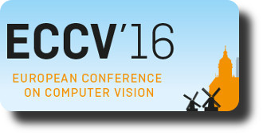


Keep it SMPL: Automatic Estimation
of 3D Human Pose and Shape
from a Single Image
Federica Bogo*
Angjoo Kanazawa*
Christoph Lassner
Peter Gehler
Javier Romero
Michael J. Black
* Equal contribution
All the work was performed at MPI
Notes:
(Jon please ignore this slide):
Hi, my name is Angjoo and I will present our work: Keep it SMPL, Automatic Estimation of 3D human pose and shape from a single image.

Slide 2
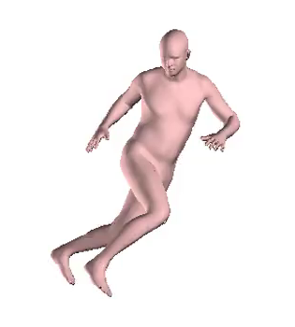
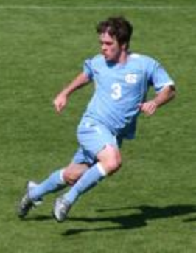
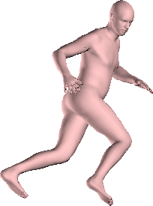
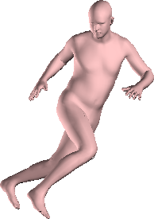
3D Shape and Pose from a Single Image
Notes:
In this work, we are given a single image of a human – without any info about body pose, scene, or camera calibration -- and we wish to obtain [show] both 3D shape and pose from the picture. This is a longstanding problem with many applications.

Slide 3
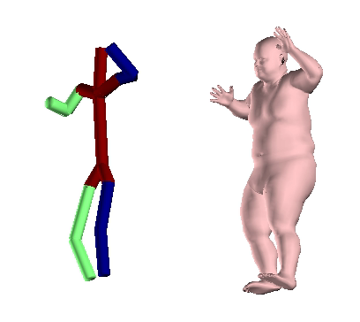
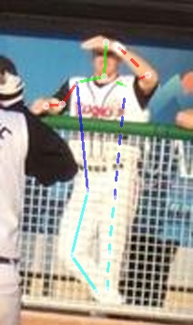
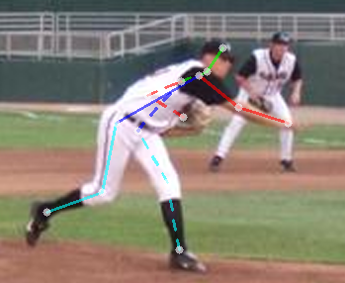
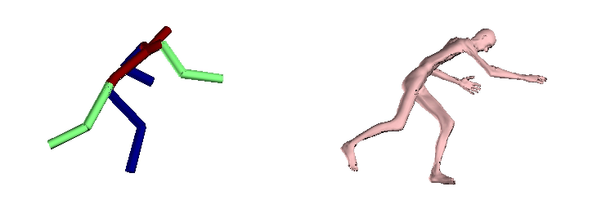
3D Pose Estimation
[Zhou CVPR ‘15]
Notes:
So far, most methods in the literature focus on just obtaining the 3D pose as a skeleton [show] without the body shape. But the human body is not just a skeleton, it has a volume. Here, the skeletons might look reasonable, BUT when we fit a body to it [show], then it’s clear that it has unnatural body proportions, or that the shoulders and hips are too narrow. These errors are not obvious from just looking at the skeleton. So it’s important to solve for the shape as well as the pose.

Slide 4
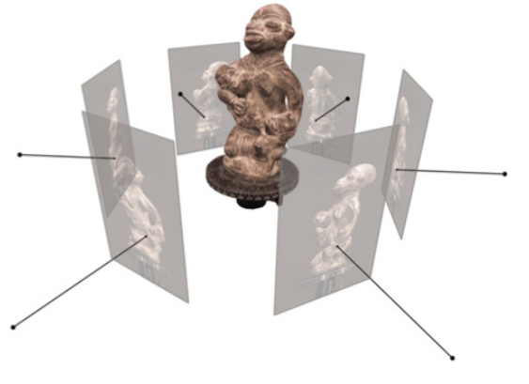
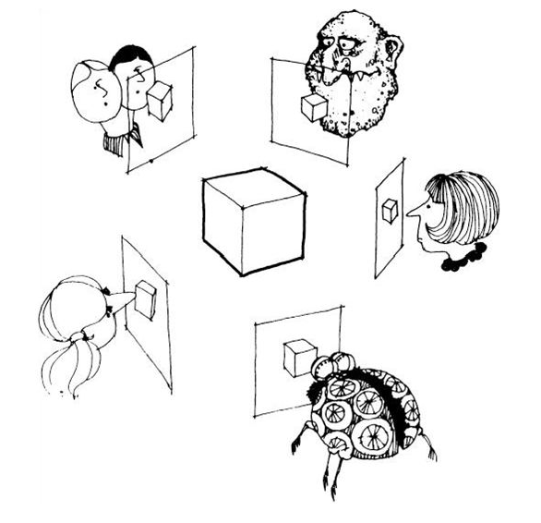
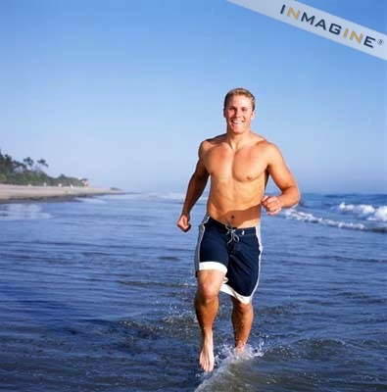
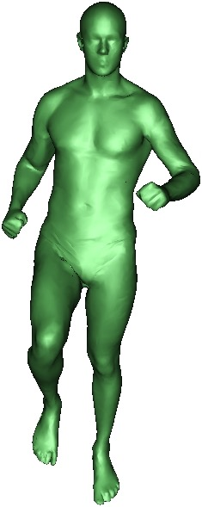
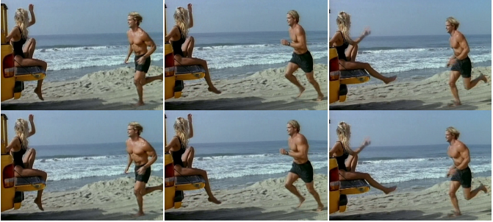
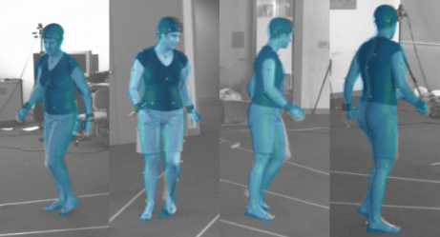
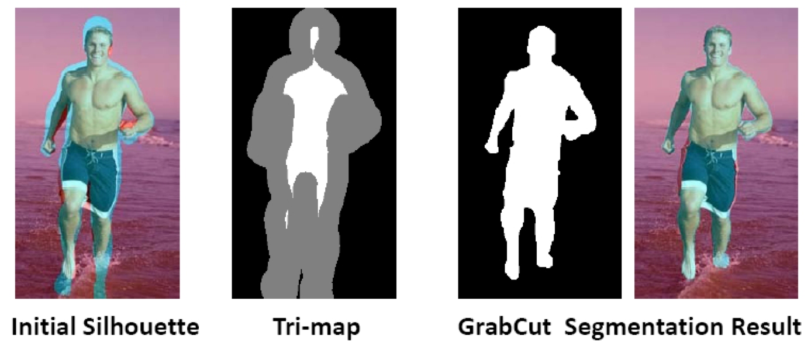

Pose and Shape, but …
Manual Intervention
Multiview, Sequence
Only requires a single view
Fully automatic
[Guan et al. ICCV ‘09, Hasler et al. CVPR ‘10, Zhou et al. SIGGRAPH ‘10 ]
[Bӑlan et al. CVPR '07, Jain et al. SIGGRAPH ’10,
Rhodin et al. ECCV ‘16 ]
Notes:
There are few methods that solve for both pose and shape, but require manual intervention [show]. OR multi-view or video sequence. [show]
Our approach is fully automatic, [show] and operates just with single-views.[show]

Slide 5
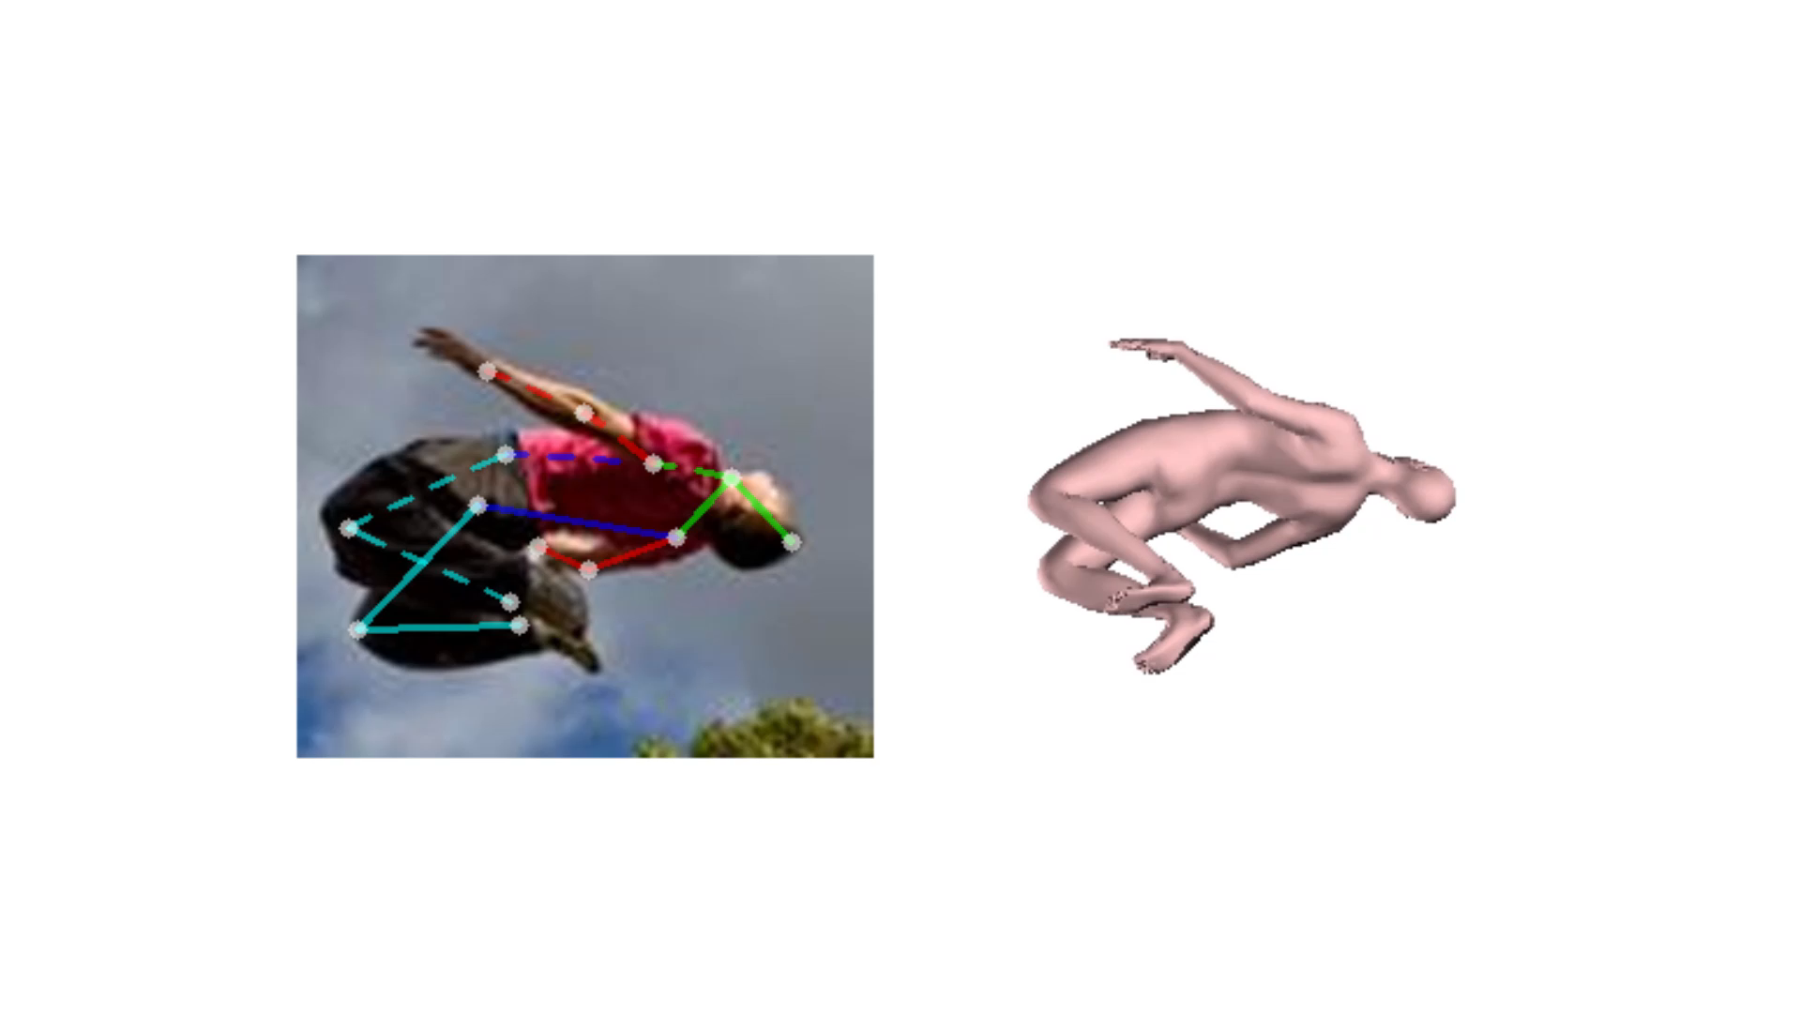
Our Results
Notes:
Furthermore, we demonstrate our approach on natural images with complex poses.
Our output is realistic and can be immediately posed or animated in standard graphics pipelines.

Slide 6
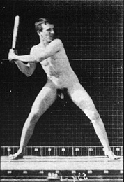
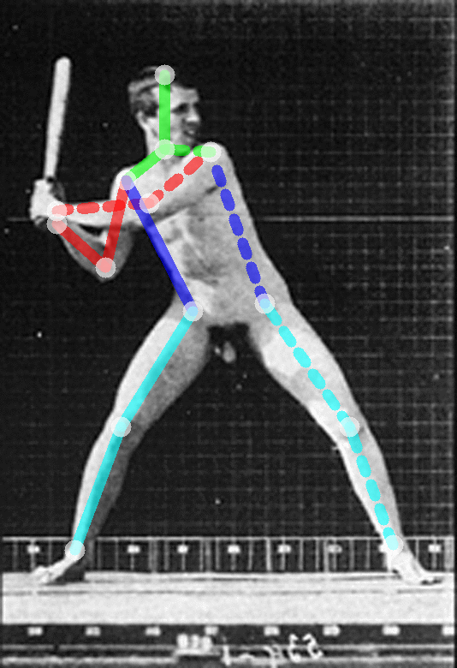
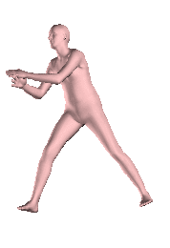
Our Results
Notes:
Our approach works on a variety of images, like this sequence from the Muybridge footage.

Slide 7
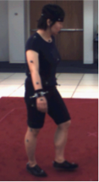
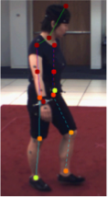
Overview
1. Automatic joint detection via CNNs
Notes:
We do this in two stages: First, [show] we estimate the locations of 2D joints using a state of the art CNNs.

Slide 8
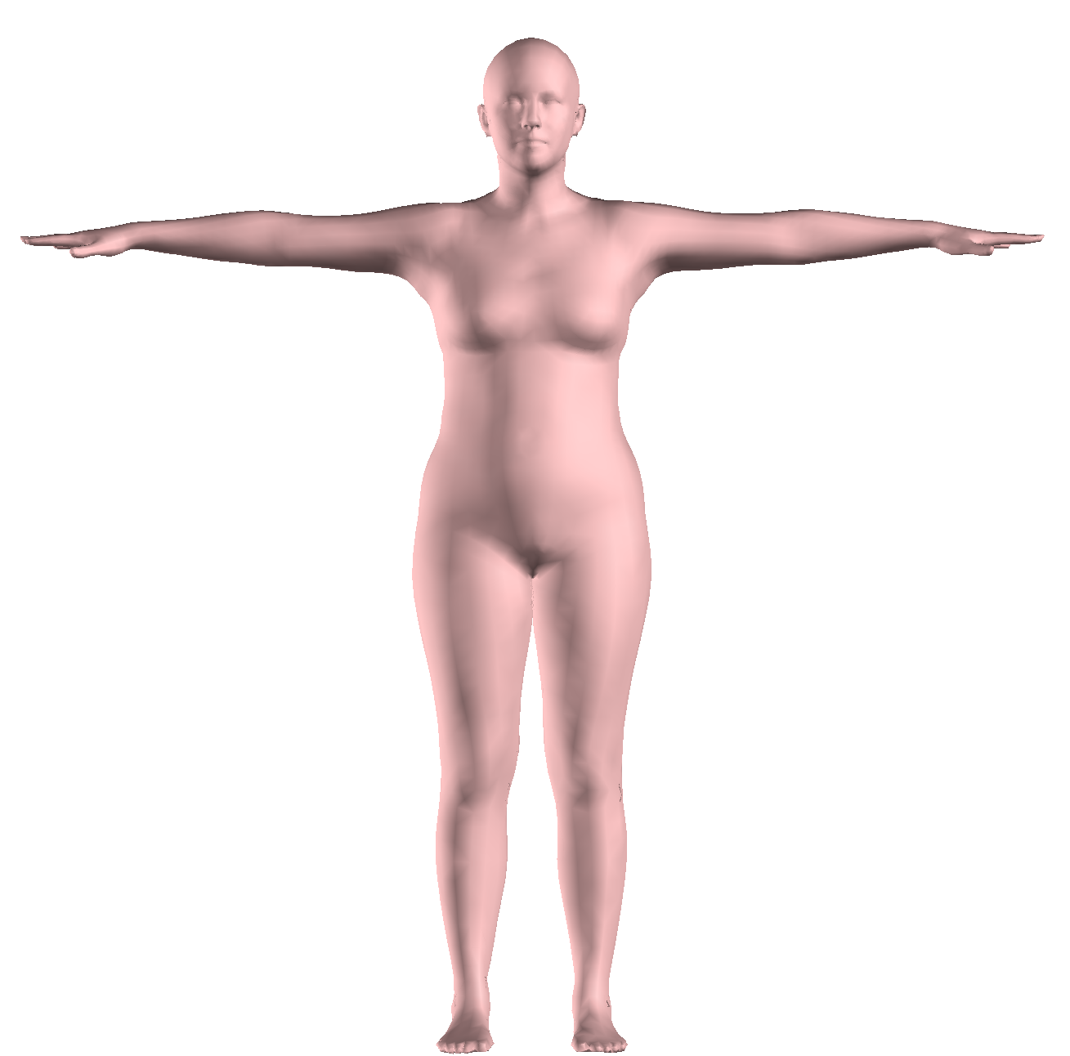
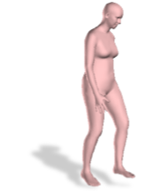
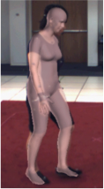
Overview
1. Automatic joint detection via CNNs
2. A good generative model of 3D pose and shape
SMPL
(Skinned Multi-Person Linear Model)
Notes:
Then, we take a generative model of 3D human bodies called SMPL and directly optimize its parameters so that the model joints project to the detected 2D joints.

Slide 9
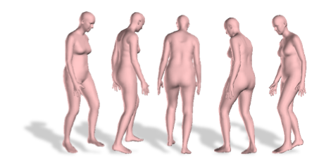
Overview
SMPLify
1. Automatic joint detection via CNNs
BOTTOM UP
2. A good generative model of 3D pose and shape
TOP DOWN
Notes:
This fits within a classical paradigm of bottom up estimation [show] followed by top down [show] verification. We can obtain shape from just the joints, because SMPL captures so much information about human body shapes. We call our approach “SMPLify”
In detail,

Slide 10
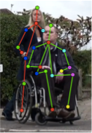
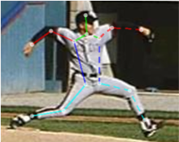
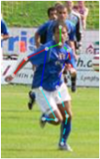

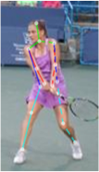
2D Joint Detection
Supervised end-to-end training to detect joints with confidence values.
[Pishchulin et al. DeepCut CVPR 2016]
Notes:
For the CNN stage, we use a recently published method called DeepCut, which outputs a set of 2D joints with confidence values.
Note that you could replace this with any 2D joint detectors

Slide 11
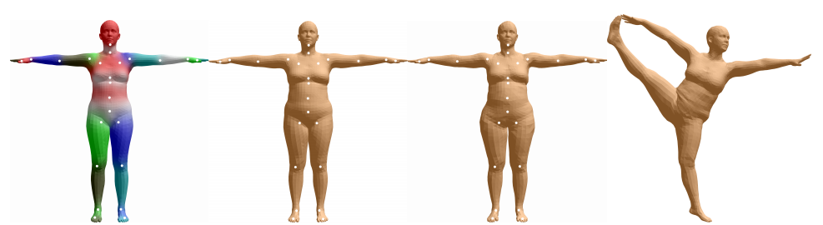
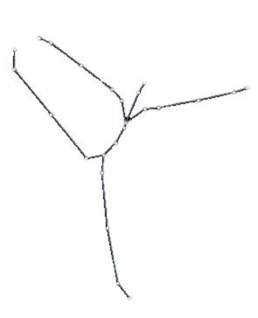
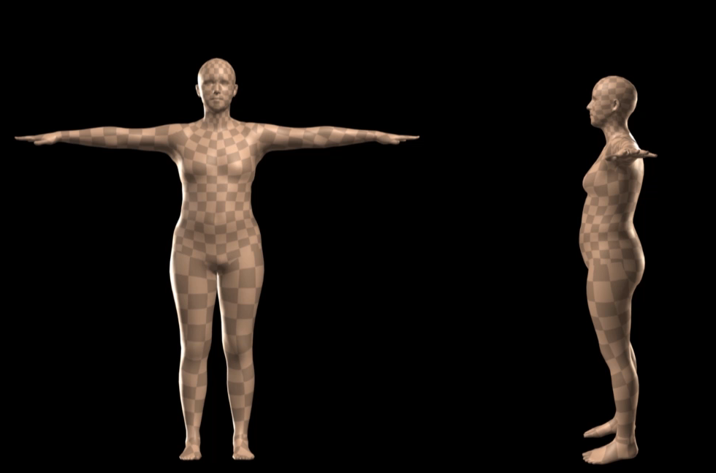


SMPL body model
Shape: PCA coefficients
Pose: Rotation of 23 joints
[Loper et al. SIGGRAPH Asia ‘15]
Notes:
For the 3D generative model of humans, we use SMPL where the human body is parameterized by SHAPE[show] and Pose [show]
The shape is characterized by the coefficients of a PCA shape space, BETA: (play video).
The POSE[show] is represented by the relative rotation of 23 joints in a kinematic tree , THETA

Slide 12
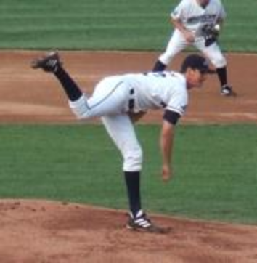
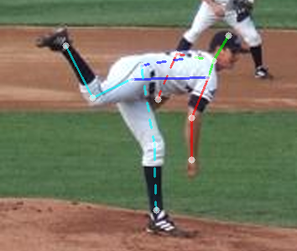
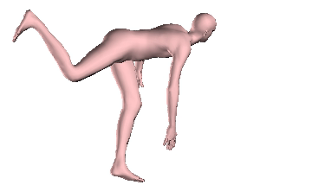
SMPLify Objective Function
camera
joints
Data term
Priors
Notes:
To fit beta and theta parameters to the detected 2D joints, we minimize [show] an objective function, which is a sum of a data term and four priors.

Slide 13
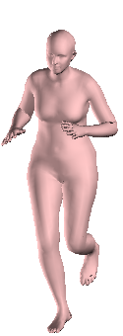
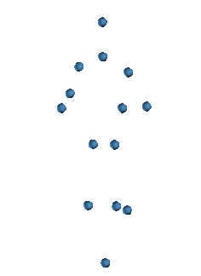
Data Term: Joint Projection Error
Notes:
The data term depends on body joints. In SMPL, the joints are [show] regressed from the shape and pose parameters.
Using these 3D joints from SMPL, we compute the joint projection error,,

Slide 14
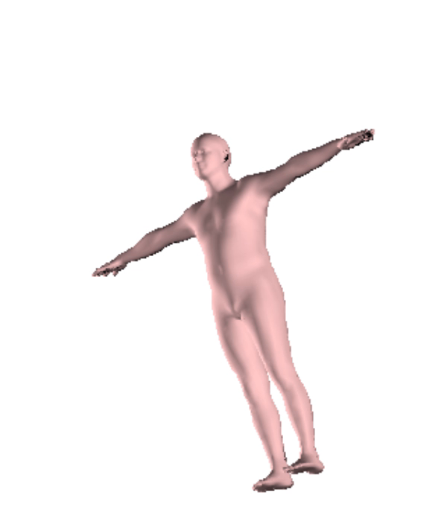
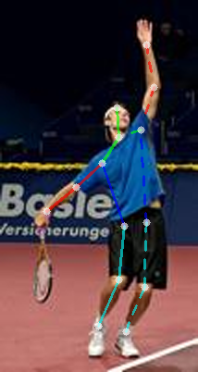
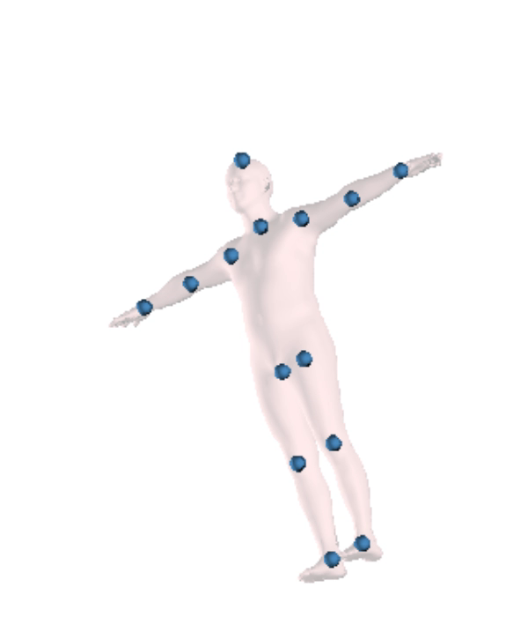
Data Term: Joint Projection Error
Camera Projection
Notes:
, which penalizes the differences between the detected 2D joints and the projected SMPL joints. We solve for the camera parameters as well.
Here, we show how SMPL change during optimization from the template to the final shape.

Slide 15



Depth Ambiguity
Fundamentally ambiguous problem
Side view
[Guan et al., Estimating human shape and pose from a single image. ICCV 2009.]
Notes:
However, this problem is fundamentally ambiguous, because many 3D poses and shapes can explain the same 2D image.
For example, given this image of a man standing, this model looks like a reasonable explanation, but if we see it from another side[show], we see that the knees are bent even though they shouldn’t be. To overcome this, we need a good prior.

Slide 16
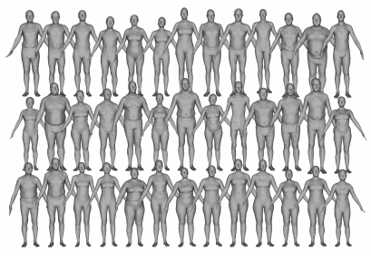
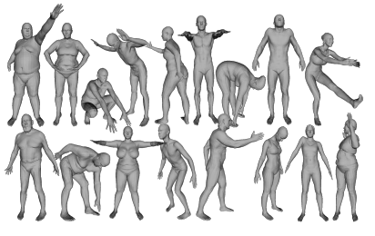
Pose and Shape Priors
Pose Prior
Shape Prior
Notes:
So, we learn a multi-modal pose prior [show] from nearly 1 million poses in the CMU mocap dataset.
For the shape prior, [show] we use SMPL’s PCA space, which was obtained from thousands of scans. This captures the statistics of human body shapes very well and is much richer than a prior on 3D skeletons.
#We also encode a prior on joint angle limits.

Slide 17

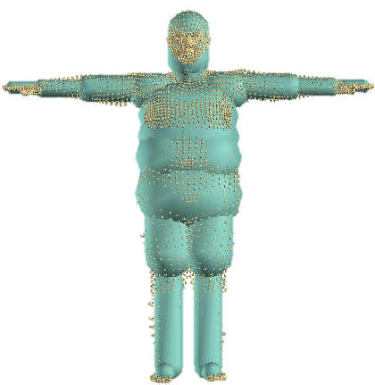
Preventing Interpenetration
Notes:
Another advantage of working with complete surfaces instead of skeletons is that we can reason about interpenetration.
We do so by approximating the surface with capsules and penalize intersections between them.

Slide 18
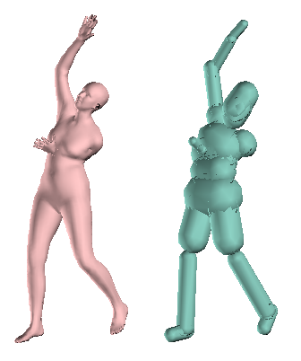
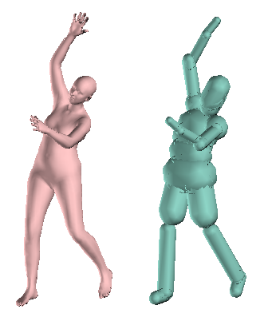
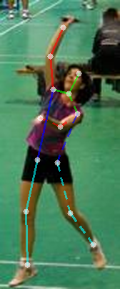
Preventing Interpenetration
Before
After
Notes:
Here is a result without the interpenetration term where [show] there is a gross intersection of the left arm and the body. Adding the interpenetration term [show] resolves this problem and makes the results qualitatively natural.

Slide 19
SMPLify Objective Function
pose and shape priors
joint angle limits
Joint projection error
interpenetration
Notes:
Our final objective function is composed of the sum of all of the energy terms.

Slide 20
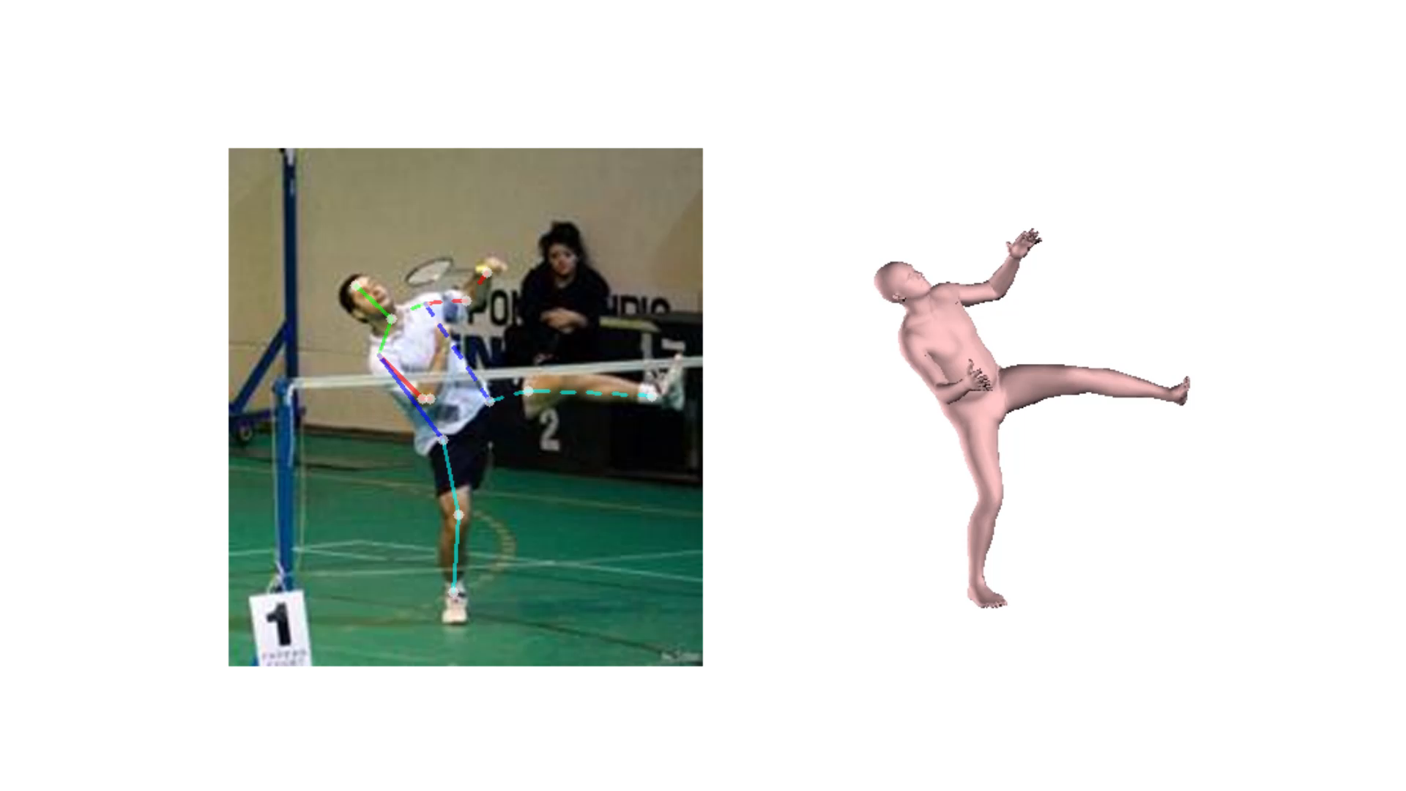
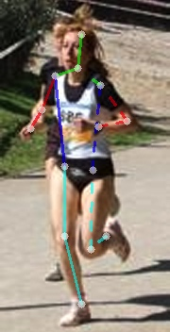
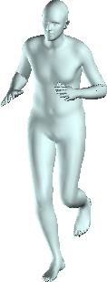




Results on Leeds Sports Poses (LSP)
Notes:
We demonstrate our approach on the Leeds Sport Poses, a highly unconstrained dataset with a wide variety of complex poses, clothing, background, and imaging conditions.
To our knowledge, no other previous approaches have demonstrated 3D mesh reconstruction on LSP images.

Slide 21

Results on Leeds Sports Poses (LSP)
Ahkter et al CVPR ‘15
Ramakrishna et al ECCV ‘12
Zhou et al CVPR ‘15
Input
SMPLify
Notes:
We also compare our approach to three methods on the task of fully automatic 3D joint estimation. All methods use the same detected 2D joints as input.
We also quantitatively evaluated our approach on two widely adopted datasets,

Slide 22


Quantitative Evaluation
Mean error:
181mm
157mm
106mm
82mm
HumanEva
Human3.6M
Ahkter et al CVPR ‘15
Ramakrishna et al ECCV ‘12
Zhou et al CVPR ‘15
Input
SMPLify
Notes:
HumanEva and Human3.6m, and achieve state of the art results.

Slide 23

Human3.6M
Mean error:
181mm
157mm
106mm
82mm
Ahkter et al CVPR ‘15
Ramakrishna et al ECCV ‘12
Zhou et al CVPR ‘15
Input
SMPLify
Notes:
We also evaluated our approach quantitatively on two widely adopted datasets, HumanEva and Human3.6m, achieving state of the art results.

Slide 24


HumanEva
194mm
168mm
110mm
80mm

Slide 25









Failure modes: CNN failure
Notes:
One of the failure modes are due to wrong detections in the 2D joints.

Slide 26









Failure modes: Depth Ambiguity
Notes:
Another failure mode is due to challenging cases of depth ambiguity. These cases maybe improved by using the appearance information in the image and occlusion reasoning.

Slide 27
Future work
Silhouettes
Multiple camera views
Video
Occlusion reasoning in image understanding
Generate training data
Notes:
Our approach is conceptually simple and easy to customize so there are many avenues for future work. Results can benefit from cues like silhouettes, multiple views and temporal information in video.
Having an explicit 3D mesh may help occlusion reasoning in image understanding, and these meshes may serve as a training data for various applications.

Slide 28



Thank You!
Code and results available at smplify.is.tue.mpg.de
Acknowledgements: We thank M. Al Borno for inspiring the capsule representation,
N. Mahmood for help with the figures, I. Akhter for helpful discussions.
Notes:
Our code and results are available online.
Thanks, and please come see our poster!

